Slide 1

CPI ANALYSIS AND Insights USING python
Tony Ciang
August 2023

Slide 2
Project Objective – CPI (CONSUMER PRICE INDEX)
To provide deeper insights to the high inflation and costs of living that Singapore has been experiencing by examining the CPI and its impact on individuals.
The insights will provide a deeper understanding into the general price movements with a drill down analysis into the weightage and price changes of the components that make up the CPI.
A python program will be created to determine user spending patterns and benchmark the results to the general household data to provide custom insights.
Notes:
We having been hearing about high inflation, increased costs of living..
So we will be deep diving into the topic on CPI have a better understanding on how all these affect our life.
From everybody all the way to the specific individual – which is you

Slide 3



Dataset | URL | Description | Notes
Weighting Pattern for 2019-based Consumer Price Index | https://www.singstat.gov.sg/-/media/files/publications/economy/excel/cpi-weights-2019-based.ashx | Contains the weightage for the 10 CPI main components which are further broken down into sub groups and elements | Using python pandas and matplotlib, the 10 main components are extracted from the dataset and used to plot the weightage in a pie chart The dataset is also loaded into a SQL database and a query is made using python to load the data into a custom program to provide custom insights over individual spending patterns
Consumer Price Index (CPI), 2019 As Base Year | https://beta.data.gov.sg/datasets/781/view | Contains the quarterly CPI data using 2019 as the base reference year | Using pandas and plotly library, an interactive trend line is used to show the CPI changes from 2019 to 2023 An interactive histogram is also created using plotly to show the distribution of the price changes with the help of a distribution plot
Average Retail Prices Of Selected Consumer Items | https://beta.data.gov.sg/datasets/764/view | Lists down the selected consumer products and services that are used as inputs for the CPI computation | Using pandas and plotly, an interactive bar chart is used to display the changes in prices of items ranked from top to bottom Using pandas, the dataset is merged with the ‘ Weighting Pattern’ dataset and shown as an interactive scatterplot
Notes:
There will be 3 dataset for the CPI –
Weightage
Component index movements by quarter
Yearly Retail prices of component items
2 of the datasets will also be joined into a merged dataset with new charts for even more insights
Pandas and Plotly will be used for the chart library
Why plotly

Slide 4
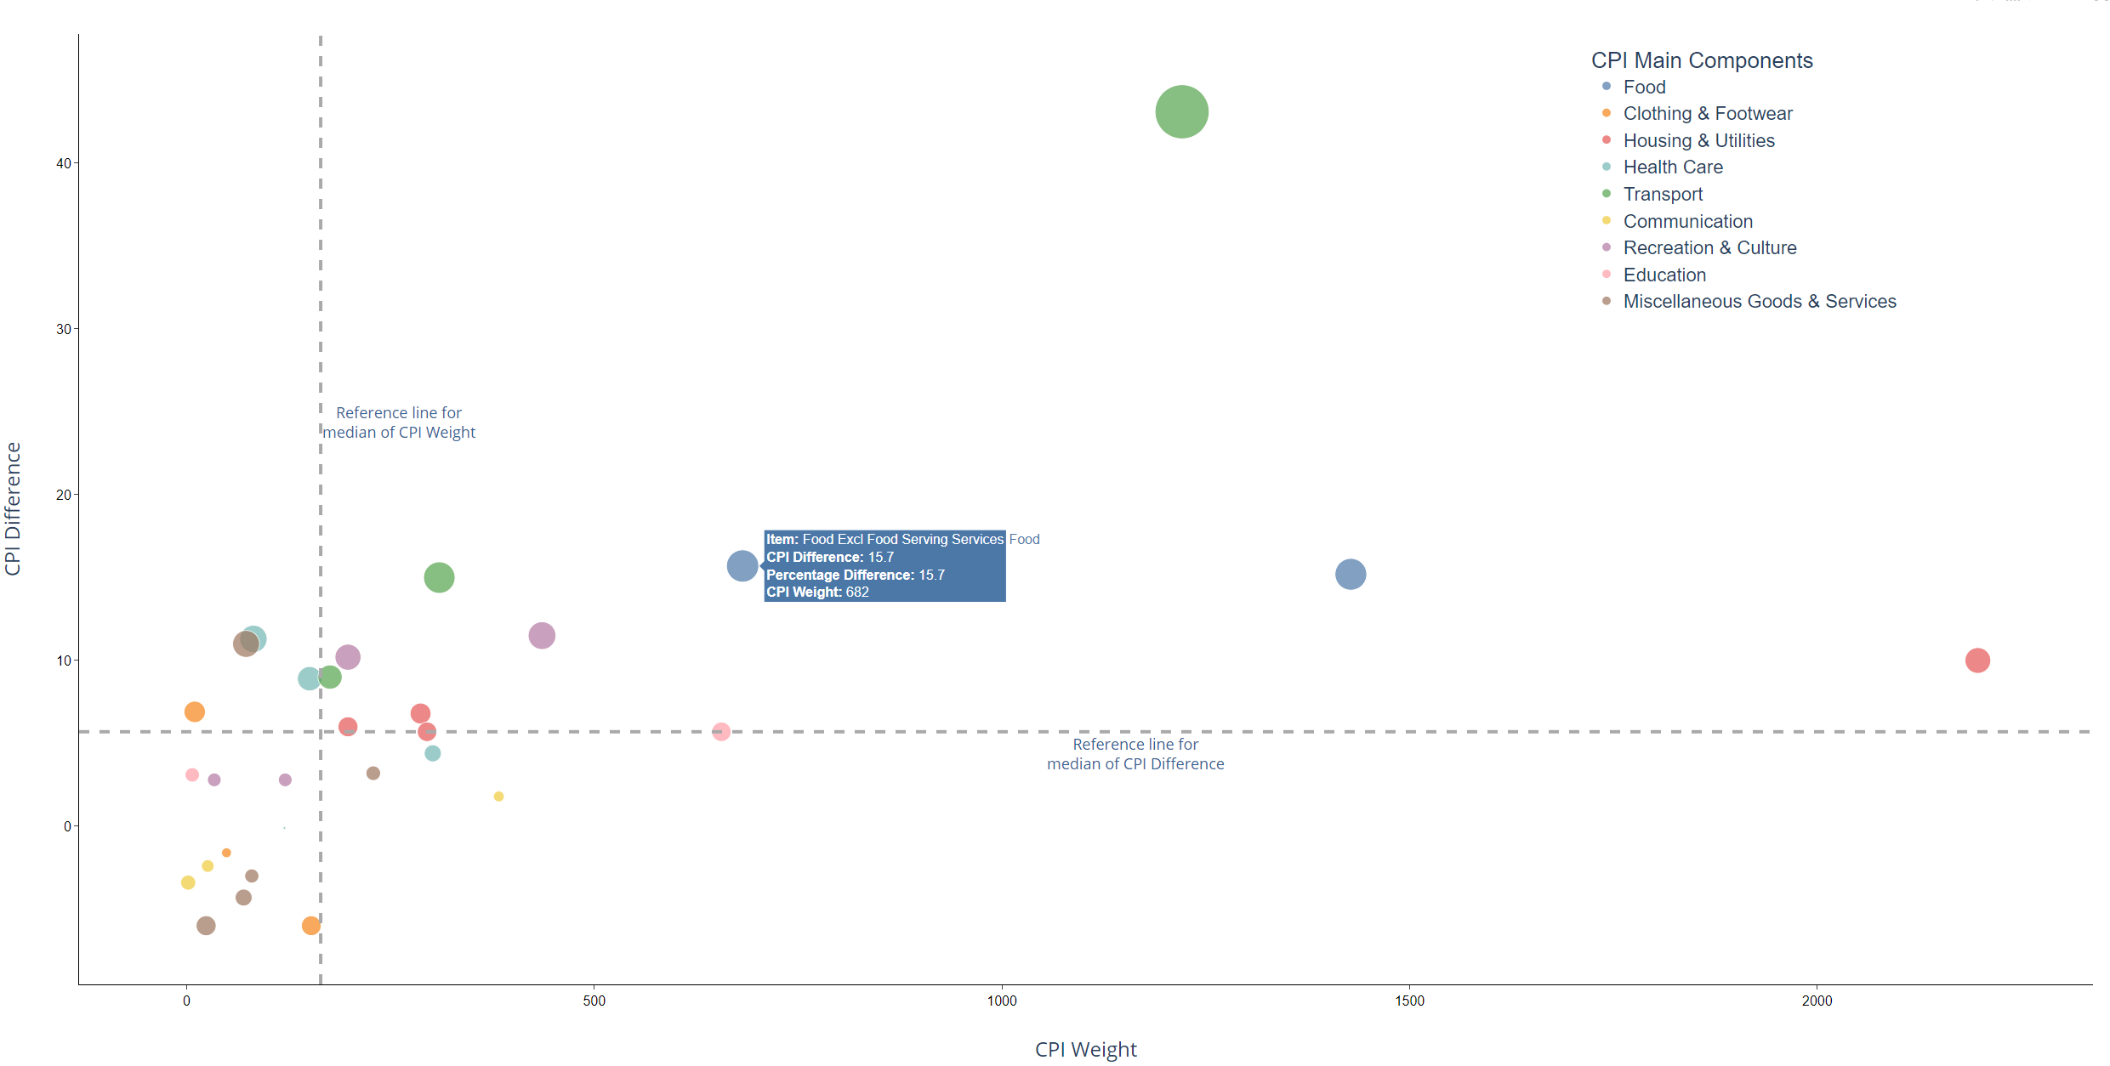
INTERACTIVE CHARTS USING PLOTLY
https://wizely08.github.io/cpi/
Free form drag and zoom
Legend with category filter function
Hover over Tooltips
Notes:
I have also converted the interactive plotly chart into a live html on my github page
Live demonstration
https://wizely08.github.io/cpi
There is the legend with filter capabilities
Pan and zoom feature
Hover tooltips for more detailed info
Additional interactive elements possible with the use of Plotly Dash

Slide 5
SAMPLE PYTHON CODE FOR SCATTERPLOT ANALYSIS WITH DATASET JOIN
Using Python libraries – Pandas & Plotly
Raw data for both dataset is loaded into a pandas DataFrame and an inner join is performed via a merge
Data is cleaned and transformed using Pandas
Custom new column for ‘Group’ is added using custom function definition
Row sub-setting is done by Boolean logic
Scatterplot is created using Plotly Express with both horizontal and vertical median lines defined
Additional customisation of chart elements and interactivity added using layout and traces layer update

Slide 6
import pandas as pd import plotly.express as px # Read the excel file into the pandas dataframe path1 = 'assets/cpi-weights-2019-based.xlsx' df1 = pd.read_excel(path1, skiprows=5, usecols=[0,1], names=['items', 'weights'], nrows=150) # Read the csv file into the pandas dataframe path2 = 'assets/CPI_Quarterly.csv' df2 = pd.read_csv(path2, sep=',', skiprows=10, nrows=152) # Rename the 'Data Series' to 'items' and remove empty spaces from the values in the column df2 = df2.rename(columns={'Data Series' : 'items'}) df2['items'] = df2['items'].str.strip() # Do an inner join between the 2 imported datasets df = pd.merge(df1, df2, how='inner', on='items') # Trim the trailing spaces from the column headers df.columns = df.columns.str.strip() # Create a new column containing the difference in CPI value for '2023 2Q' and '2019 1Q' df['diff'] = df['2023 2Q'] - df['2019 1Q'] df['diff'] = df['diff'].round(1) # Create a new column containing the percent difference in CPI value for '2023 2Q' and '2019 1Q' df['per_diff'] = (df['2023 2Q'] - df['2019 1Q']) / df['2019 1Q'] * 100 df['per_diff'] = df['per_diff'].round(1) df['per_diff'] = df['per_diff'].apply(abs) # Create the lists for the main and sub categories main_category = ['Food', 'Clothing & Footwear', 'Housing & Utilities', 'Household Durables & Services', 'Health Care', 'Transport', 'Communication', 'Recreation & Culture', 'Education', 'Miscellaneous Goods & Services'] sub_category = ['Food Excl Food Serving Services', 'Food Serving Services', 'Clothing', 'Other Articles & Related Services', 'Footwear', 'Accommodation', 'Utilities & Other Fuels', 'Household Durables', 'Household Services & Supplies', 'Medicines & Health Products', 'Outpatient Services', 'Hospital Services', 'Health Insurance', 'Private Transport', 'Public Transport', 'Other Transport Services', 'Postage & Courier Services', 'Telecommunication Equipment', 'Telecommunication Services', 'Recreational & Cultural Goods', 'Recreational & Cultural Services', 'Newspapers, Books & Stationery', 'Holiday Expenses', 'Tuition & Other Fees', 'Textbooks & Study Guides', 'Personal Care', 'Alcoholic Drinks & Tobacco', 'Personal Effects', 'Social Services', 'Other Miscellaneous Services'] # Define the dictionary for the main group elements main_group = { 'Food' : ['Food Excl Food Serving Services', 'Food Serving Services'], 'Clothing & Footwear' : ['Clothing', 'Other Articles & Related Services', 'Footwear'], 'Housing & Utilities' : ['Accommodation', 'Utilities & Other Fuels', 'Household Durables', 'Household Services & Supplies'], 'Health Care' : ['Medicines & Health Products', 'Outpatient Services', 'Hospital Services', 'Health Insurance'], 'Transport' : ['Private Transport', 'Public Transport', 'Other Transport Services'], 'Communication' : ['Postage & Courier Services', 'Telecommunication Equipment', 'Telecommunication Services'], 'Recreation & Culture' : ['Recreational & Cultural Goods', 'Recreational & Cultural Services', 'Newspapers, Books & Stationery', 'Holiday Expenses'], 'Education' : ['Tuition & Other Fees', 'Textbooks & Study Guides'], 'Miscellaneous Goods & Services' : ['Personal Care', 'Alcoholic Drinks & Tobacco', 'Personal Effects', 'Social Services', 'Other Miscellaneous Services'] } # Create a function to map the 'items' column to the corresponding main group def map_to_group(value): for group, values in main_group.items(): if value in values: return group return None # Apply the mapping function to create the 'group' column df['group'] = df['items'].apply(map_to_group) # Filter the rows required based on the sub category df_main = df[df['items'].isin(main_category)] df_sub = df[df['items'].isin(sub_category)] # Create the scatter plot using Plotly Express fig = px.scatter( df_sub, x='weights', y='diff', color='group', color_discrete_sequence=px.colors.qualitative.T10, size='per_diff', size_max=45, hover_data=['items'] ) # Add a vertical reference line at the median value for 'weights' fig.add_vline( type='line', x=df_sub['weights'].median(), line_width=4, line_dash='dash', line_color='darkgray' ) # Add a horizontal reference line at the median value for 'CPI Difference' fig.add_hline( y=df_sub['diff'].median(), line_width=4, line_dash='dash', line_color='darkgray' ) # Update plotly layout layer with the custom settings for chart title, xaxis, yaxis, plot background and legend fig.update_layout( title={ 'text': '', 'x': 0.5, 'font': {'family': 'Arial', 'size': 32, 'color': 'black'}, 'pad': {'b': 0, 't': 0} }, xaxis=dict( title='CPI Weight', title_standoff=40, # Add space padding for the x-axis title title_font={'size': 24}, showgrid=False, showline=True, linewidth=1, linecolor='black', showticklabels=True, ticks='outside', tickfont=dict( family='Arial', size=16, color='rgb(0, 0, 0)', ) ), yaxis=dict( title='CPI Difference', title_standoff=40, # Add space padding for the x-axis title title_font={'size': 24}, showgrid=False, showline=True, linewidth=1, linecolor='black', zeroline=False, showticklabels=True, ticks='outside', tickfont=dict( family='Arial', size=16, color='rgb(0, 0, 0)', ) ), plot_bgcolor='rgba(0, 0, 0, 0)', showlegend=True, legend=dict( title='CPI Main Components', title_font={'family': 'Arial', 'size': 26}, font={'family': 'Arial', 'size': 22}, orientation='v', # Set legend orientation to vertical yanchor='bottom', y=0.70, xanchor='left', x=0.75, bgcolor='rgba(255, 255, 255, 0.8)' ) ) # Add the text label for the horizontal reference line label_annotation_hline = dict( x=df_sub['weights'].median() + 1000, # Adjust the x-coordinate of the label y=df_sub['diff'].median(), text='Reference line for<br>median of CPI Difference', # Label text showarrow=False, xanchor='center', yanchor='top', font=dict(color='#316395', size=18) # Label text color ) fig.add_annotation(label_annotation_hline) # Add the text label for the vertical reference line label_annotation_vline = dict( x=df_sub['weights'].median(), y=df_sub['diff'].median() + 20, # Adjust the y-coordinate of the label text='Reference line for<br>median of CPI Weight', # Label text showarrow=False, xanchor='left', yanchor='top', font=dict(color='#316395', size=18) # Label text color ) fig.add_annotation(label_annotation_vline) # Update hover tooltip display using update_traces fig.update_traces( hovertemplate='<b>Item:</b> %{customdata[0]}<br>' '<b>CPI Difference:</b> %{y}<br>' '<b>Percentage Difference:</b> %{marker.size}<br>' '<b>CPI Weight:</b> %{x}', hoverlabel = dict(font_size = 16, font_family = 'Arial') ) # Show the scatter plot fig.show() fig.write_html('cpi_scatter.html') fig.write_image('cpi_scatter.jpg')

Slide 7
import pandas as pd import plotly.express as px # Read the excel file into the pandas dataframe path1 = 'assets/cpi-weights-2019-based.xlsx' df1 = pd.read_excel(path1, skiprows=5, usecols=[0,1], names=['items', 'weights'], nrows=150) # Read the csv file into the pandas dataframe path2 = 'assets/CPI_Quarterly.csv' df2 = pd.read_csv(path2, sep=',', skiprows=10, nrows=152) # Rename the 'Data Series' to 'items' and remove empty spaces from the values in the column df2 = df2.rename(columns={'Data Series' : 'items'}) df2['items'] = df2['items'].str.strip() # Do an inner join between the 2 imported datasets df = pd.merge(df1, df2, how='inner', on='items') # Trim the trailing spaces from the column headers df.columns = df.columns.str.strip() # Create a new column containing the difference in CPI value for '2023 2Q' and '2019 1Q' df['diff'] = df['2023 2Q'] - df['2019 1Q'] df['diff'] = df['diff'].round(1) # Create a new column containing the percent difference in CPI value for '2023 2Q' and '2019 1Q' df['per_diff'] = (df['2023 2Q'] - df['2019 1Q']) / df['2019 1Q'] * 100 df['per_diff'] = df['per_diff'].round(1) df['per_diff'] = df['per_diff'].apply(abs) # Create the lists for the main and sub categories main_category = ['Food', 'Clothing & Footwear', 'Housing & Utilities', 'Household Durables & Services', 'Health Care', 'Transport', 'Communication', 'Recreation & Culture', 'Education', 'Miscellaneous Goods & Services'] sub_category = ['Food Excl Food Serving Services', 'Food Serving Services', 'Clothing', 'Other Articles & Related Services', 'Footwear', 'Accommodation', 'Utilities & Other Fuels', 'Household Durables', 'Household Services & Supplies', 'Medicines & Health Products', 'Outpatient Services', 'Hospital Services', 'Health Insurance', 'Private Transport', 'Public Transport', 'Other Transport Services', 'Postage & Courier Services', 'Telecommunication Equipment', 'Telecommunication Services', 'Recreational & Cultural Goods', 'Recreational & Cultural Services', 'Newspapers, Books & Stationery', 'Holiday Expenses', 'Tuition & Other Fees', 'Textbooks & Study Guides', 'Personal Care', 'Alcoholic Drinks & Tobacco', 'Personal Effects', 'Social Services', 'Other Miscellaneous Services'] # Define the dictionary for the main group elements main_group = { 'Food' : ['Food Excl Food Serving Services', 'Food Serving Services'], 'Clothing & Footwear' : ['Clothing', 'Other Articles & Related Services', 'Footwear'], 'Housing & Utilities' : ['Accommodation', 'Utilities & Other Fuels', 'Household Durables', 'Household Services & Supplies'], 'Health Care' : ['Medicines & Health Products', 'Outpatient Services', 'Hospital Services', 'Health Insurance'], 'Transport' : ['Private Transport', 'Public Transport', 'Other Transport Services'], 'Communication' : ['Postage & Courier Services', 'Telecommunication Equipment', 'Telecommunication Services'], 'Recreation & Culture' : ['Recreational & Cultural Goods', 'Recreational & Cultural Services', 'Newspapers, Books & Stationery', 'Holiday Expenses'], 'Education' : ['Tuition & Other Fees', 'Textbooks & Study Guides'], 'Miscellaneous Goods & Services' : ['Personal Care', 'Alcoholic Drinks & Tobacco', 'Personal Effects', 'Social Services', 'Other Miscellaneous Services'] } # Create a function to map the 'items' column to the corresponding main group def map_to_group(value): for group, values in main_group.items(): if value in values: return group return None # Apply the mapping function to create the 'group' column df['group'] = df['items'].apply(map_to_group) # Filter the rows required based on the sub category df_main = df[df['items'].isin(main_category)] df_sub = df[df['items'].isin(sub_category)] # Create the scatter plot using Plotly Express fig = px.scatter( df_sub, x='weights', y='diff', color='group', color_discrete_sequence=px.colors.qualitative.T10, size='per_diff', size_max=45, hover_data=['items'] ) # Add a vertical reference line at the median value for 'weights' fig.add_vline( type='line', x=df_sub['weights'].median(), line_width=4, line_dash='dash', line_color='darkgray' ) # Add a horizontal reference line at the median value for 'CPI Difference' fig.add_hline( y=df_sub['diff'].median(), line_width=4, line_dash='dash', line_color='darkgray' ) # Update plotly layout layer with the custom settings for chart title, xaxis, yaxis, plot background and legend fig.update_layout( title={ 'text': '', 'x': 0.5, 'font': {'family': 'Arial', 'size': 32, 'color': 'black'}, 'pad': {'b': 0, 't': 0} }, xaxis=dict( title='CPI Weight', title_standoff=40, # Add space padding for the x-axis title title_font={'size': 24}, showgrid=False, showline=True, linewidth=1, linecolor='black', showticklabels=True, ticks='outside', tickfont=dict( family='Arial', size=16, color='rgb(0, 0, 0)', ) ), yaxis=dict( title='CPI Difference', title_standoff=40, # Add space padding for the x-axis title title_font={'size': 24}, showgrid=False, showline=True, linewidth=1, linecolor='black', zeroline=False, showticklabels=True, ticks='outside', tickfont=dict( family='Arial', size=16, color='rgb(0, 0, 0)', ) ), plot_bgcolor='rgba(0, 0, 0, 0)', showlegend=True, legend=dict( title='CPI Main Components', title_font={'family': 'Arial', 'size': 26}, font={'family': 'Arial', 'size': 22}, orientation='v', # Set legend orientation to vertical yanchor='bottom', y=0.70, xanchor='left', x=0.75, bgcolor='rgba(255, 255, 255, 0.8)' ) ) # Add the text label for the horizontal reference line label_annotation_hline = dict( x=df_sub['weights'].median() + 1000, # Adjust the x-coordinate of the label y=df_sub['diff'].median(), text='Reference line for<br>median of CPI Difference', # Label text showarrow=False, xanchor='center', yanchor='top', font=dict(color='#316395', size=18) # Label text color ) fig.add_annotation(label_annotation_hline) # Add the text label for the vertical reference line label_annotation_vline = dict( x=df_sub['weights'].median(), y=df_sub['diff'].median() + 20, # Adjust the y-coordinate of the label text='Reference line for<br>median of CPI Weight', # Label text showarrow=False, xanchor='left', yanchor='top', font=dict(color='#316395', size=18) # Label text color ) fig.add_annotation(label_annotation_vline) # Update hover tooltip display using update_traces fig.update_traces( hovertemplate='<b>Item:</b> %{customdata[0]}<br>' '<b>CPI Difference:</b> %{y}<br>' '<b>Percentage Difference:</b> %{marker.size}<br>' '<b>CPI Weight:</b> %{x}', hoverlabel = dict(font_size = 16, font_family = 'Arial') ) # Show the scatter plot fig.show() fig.write_html('cpi_scatter.html') fig.write_image('cpi_scatter.jpg')

Slide 8
import pandas as pd import plotly.express as px # Read the excel file into the pandas dataframe path1 = 'assets/cpi-weights-2019-based.xlsx' df1 = pd.read_excel(path1, skiprows=5, usecols=[0,1], names=['items', 'weights'], nrows=150) # Read the csv file into the pandas dataframe path2 = 'assets/CPI_Quarterly.csv' df2 = pd.read_csv(path2, sep=',', skiprows=10, nrows=152) # Rename the 'Data Series' to 'items' and remove empty spaces from the values in the column df2 = df2.rename(columns={'Data Series' : 'items'}) df2['items'] = df2['items'].str.strip() # Do an inner join between the 2 imported datasets df = pd.merge(df1, df2, how='inner', on='items') # Trim the trailing spaces from the column headers df.columns = df.columns.str.strip() # Create a new column containing the difference in CPI value for '2023 2Q' and '2019 1Q' df['diff'] = df['2023 2Q'] - df['2019 1Q'] df['diff'] = df['diff'].round(1) # Create a new column containing the percent difference in CPI value for '2023 2Q' and '2019 1Q' df['per_diff'] = (df['2023 2Q'] - df['2019 1Q']) / df['2019 1Q'] * 100 df['per_diff'] = df['per_diff'].round(1) df['per_diff'] = df['per_diff'].apply(abs) # Create the lists for the main and sub categories main_category = ['Food', 'Clothing & Footwear', 'Housing & Utilities', 'Household Durables & Services', 'Health Care', 'Transport', 'Communication', 'Recreation & Culture', 'Education', 'Miscellaneous Goods & Services'] sub_category = ['Food Excl Food Serving Services', 'Food Serving Services', 'Clothing', 'Other Articles & Related Services', 'Footwear', 'Accommodation', 'Utilities & Other Fuels', 'Household Durables', 'Household Services & Supplies', 'Medicines & Health Products', 'Outpatient Services', 'Hospital Services', 'Health Insurance', 'Private Transport', 'Public Transport', 'Other Transport Services', 'Postage & Courier Services', 'Telecommunication Equipment', 'Telecommunication Services', 'Recreational & Cultural Goods', 'Recreational & Cultural Services', 'Newspapers, Books & Stationery', 'Holiday Expenses', 'Tuition & Other Fees', 'Textbooks & Study Guides', 'Personal Care', 'Alcoholic Drinks & Tobacco', 'Personal Effects', 'Social Services', 'Other Miscellaneous Services'] # Define the dictionary for the main group elements main_group = { 'Food' : ['Food Excl Food Serving Services', 'Food Serving Services'], 'Clothing & Footwear' : ['Clothing', 'Other Articles & Related Services', 'Footwear'], 'Housing & Utilities' : ['Accommodation', 'Utilities & Other Fuels', 'Household Durables', 'Household Services & Supplies'], 'Health Care' : ['Medicines & Health Products', 'Outpatient Services', 'Hospital Services', 'Health Insurance'], 'Transport' : ['Private Transport', 'Public Transport', 'Other Transport Services'], 'Communication' : ['Postage & Courier Services', 'Telecommunication Equipment', 'Telecommunication Services'], 'Recreation & Culture' : ['Recreational & Cultural Goods', 'Recreational & Cultural Services', 'Newspapers, Books & Stationery', 'Holiday Expenses'], 'Education' : ['Tuition & Other Fees', 'Textbooks & Study Guides'], 'Miscellaneous Goods & Services' : ['Personal Care', 'Alcoholic Drinks & Tobacco', 'Personal Effects', 'Social Services', 'Other Miscellaneous Services'] } # Create a function to map the 'items' column to the corresponding main group def map_to_group(value): for group, values in main_group.items(): if value in values: return group return None # Apply the mapping function to create the 'group' column df['group'] = df['items'].apply(map_to_group) # Filter the rows required based on the sub category df_main = df[df['items'].isin(main_category)] df_sub = df[df['items'].isin(sub_category)] # Create the scatter plot using Plotly Express fig = px.scatter( df_sub, x='weights', y='diff', color='group', color_discrete_sequence=px.colors.qualitative.T10, size='per_diff', size_max=45, hover_data=['items'] ) # Add a vertical reference line at the median value for 'weights' fig.add_vline( type='line', x=df_sub['weights'].median(), line_width=4, line_dash='dash', line_color='darkgray' ) # Add a horizontal reference line at the median value for 'CPI Difference' fig.add_hline( y=df_sub['diff'].median(), line_width=4, line_dash='dash', line_color='darkgray' ) # Update plotly layout layer with the custom settings for chart title, xaxis, yaxis, plot background and legend fig.update_layout( title={ 'text': '', 'x': 0.5, 'font': {'family': 'Arial', 'size': 32, 'color': 'black'}, 'pad': {'b': 0, 't': 0} }, xaxis=dict( title='CPI Weight', title_standoff=40, # Add space padding for the x-axis title title_font={'size': 24}, showgrid=False, showline=True, linewidth=1, linecolor='black', showticklabels=True, ticks='outside', tickfont=dict( family='Arial', size=16, color='rgb(0, 0, 0)', ) ), yaxis=dict( title='CPI Difference', title_standoff=40, # Add space padding for the x-axis title title_font={'size': 24}, showgrid=False, showline=True, linewidth=1, linecolor='black', zeroline=False, showticklabels=True, ticks='outside', tickfont=dict( family='Arial', size=16, color='rgb(0, 0, 0)', ) ), plot_bgcolor='rgba(0, 0, 0, 0)', showlegend=True, legend=dict( title='CPI Main Components', title_font={'family': 'Arial', 'size': 26}, font={'family': 'Arial', 'size': 22}, orientation='v', # Set legend orientation to vertical yanchor='bottom', y=0.70, xanchor='left', x=0.75, bgcolor='rgba(255, 255, 255, 0.8)' ) ) # Add the text label for the horizontal reference line label_annotation_hline = dict( x=df_sub['weights'].median() + 1000, # Adjust the x-coordinate of the label y=df_sub['diff'].median(), text='Reference line for<br>median of CPI Difference', # Label text showarrow=False, xanchor='center', yanchor='top', font=dict(color='#316395', size=18) # Label text color ) fig.add_annotation(label_annotation_hline) # Add the text label for the vertical reference line label_annotation_vline = dict( x=df_sub['weights'].median(), y=df_sub['diff'].median() + 20, # Adjust the y-coordinate of the label text='Reference line for<br>median of CPI Weight', # Label text showarrow=False, xanchor='left', yanchor='top', font=dict(color='#316395', size=18) # Label text color ) fig.add_annotation(label_annotation_vline) # Update hover tooltip display using update_traces fig.update_traces( hovertemplate='<b>Item:</b> %{customdata[0]}<br>' '<b>CPI Difference:</b> %{y}<br>' '<b>Percentage Difference:</b> %{marker.size}<br>' '<b>CPI Weight:</b> %{x}', hoverlabel = dict(font_size = 16, font_family = 'Arial') ) # Show the scatter plot fig.show() fig.write_html('cpi_scatter.html') fig.write_image('cpi_scatter.jpg')

Slide 9
import pandas as pd import plotly.express as px # Read the excel file into the pandas dataframe path1 = 'assets/cpi-weights-2019-based.xlsx' df1 = pd.read_excel(path1, skiprows=5, usecols=[0,1], names=['items', 'weights'], nrows=150) # Read the csv file into the pandas dataframe path2 = 'assets/CPI_Quarterly.csv' df2 = pd.read_csv(path2, sep=',', skiprows=10, nrows=152) # Rename the 'Data Series' to 'items' and remove empty spaces from the values in the column df2 = df2.rename(columns={'Data Series' : 'items'}) df2['items'] = df2['items'].str.strip() # Do an inner join between the 2 imported datasets df = pd.merge(df1, df2, how='inner', on='items') # Trim the trailing spaces from the column headers df.columns = df.columns.str.strip() # Create a new column containing the difference in CPI value for '2023 2Q' and '2019 1Q' df['diff'] = df['2023 2Q'] - df['2019 1Q'] df['diff'] = df['diff'].round(1) # Create a new column containing the percent difference in CPI value for '2023 2Q' and '2019 1Q' df['per_diff'] = (df['2023 2Q'] - df['2019 1Q']) / df['2019 1Q'] * 100 df['per_diff'] = df['per_diff'].round(1) df['per_diff'] = df['per_diff'].apply(abs) # Create the lists for the main and sub categories main_category = ['Food', 'Clothing & Footwear', 'Housing & Utilities', 'Household Durables & Services', 'Health Care', 'Transport', 'Communication', 'Recreation & Culture', 'Education', 'Miscellaneous Goods & Services'] sub_category = ['Food Excl Food Serving Services', 'Food Serving Services', 'Clothing', 'Other Articles & Related Services', 'Footwear', 'Accommodation', 'Utilities & Other Fuels', 'Household Durables', 'Household Services & Supplies', 'Medicines & Health Products', 'Outpatient Services', 'Hospital Services', 'Health Insurance', 'Private Transport', 'Public Transport', 'Other Transport Services', 'Postage & Courier Services', 'Telecommunication Equipment', 'Telecommunication Services', 'Recreational & Cultural Goods', 'Recreational & Cultural Services', 'Newspapers, Books & Stationery', 'Holiday Expenses', 'Tuition & Other Fees', 'Textbooks & Study Guides', 'Personal Care', 'Alcoholic Drinks & Tobacco', 'Personal Effects', 'Social Services', 'Other Miscellaneous Services'] # Define the dictionary for the main group elements main_group = { 'Food' : ['Food Excl Food Serving Services', 'Food Serving Services'], 'Clothing & Footwear' : ['Clothing', 'Other Articles & Related Services', 'Footwear'], 'Housing & Utilities' : ['Accommodation', 'Utilities & Other Fuels', 'Household Durables', 'Household Services & Supplies'], 'Health Care' : ['Medicines & Health Products', 'Outpatient Services', 'Hospital Services', 'Health Insurance'], 'Transport' : ['Private Transport', 'Public Transport', 'Other Transport Services'], 'Communication' : ['Postage & Courier Services', 'Telecommunication Equipment', 'Telecommunication Services'], 'Recreation & Culture' : ['Recreational & Cultural Goods', 'Recreational & Cultural Services', 'Newspapers, Books & Stationery', 'Holiday Expenses'], 'Education' : ['Tuition & Other Fees', 'Textbooks & Study Guides'], 'Miscellaneous Goods & Services' : ['Personal Care', 'Alcoholic Drinks & Tobacco', 'Personal Effects', 'Social Services', 'Other Miscellaneous Services'] } # Create a function to map the 'items' column to the corresponding main group def map_to_group(value): for group, values in main_group.items(): if value in values: return group return None # Apply the mapping function to create the 'group' column df['group'] = df['items'].apply(map_to_group) # Filter the rows required based on the sub category df_main = df[df['items'].isin(main_category)] df_sub = df[df['items'].isin(sub_category)] # Create the scatter plot using Plotly Express fig = px.scatter( df_sub, x='weights', y='diff', color='group', color_discrete_sequence=px.colors.qualitative.T10, size='per_diff', size_max=45, hover_data=['items'] ) # Add a vertical reference line at the median value for 'weights' fig.add_vline( type='line', x=df_sub['weights'].median(), line_width=4, line_dash='dash', line_color='darkgray' ) # Add a horizontal reference line at the median value for 'CPI Difference' fig.add_hline( y=df_sub['diff'].median(), line_width=4, line_dash='dash', line_color='darkgray' ) # Update plotly layout layer with the custom settings for chart title, xaxis, yaxis, plot background and legend fig.update_layout( title={ 'text': '', 'x': 0.5, 'font': {'family': 'Arial', 'size': 32, 'color': 'black'}, 'pad': {'b': 0, 't': 0} }, xaxis=dict( title='CPI Weight', title_standoff=40, # Add space padding for the x-axis title title_font={'size': 24}, showgrid=False, showline=True, linewidth=1, linecolor='black', showticklabels=True, ticks='outside', tickfont=dict( family='Arial', size=16, color='rgb(0, 0, 0)', ) ), yaxis=dict( title='CPI Difference', title_standoff=40, # Add space padding for the x-axis title title_font={'size': 24}, showgrid=False, showline=True, linewidth=1, linecolor='black', zeroline=False, showticklabels=True, ticks='outside', tickfont=dict( family='Arial', size=16, color='rgb(0, 0, 0)', ) ), plot_bgcolor='rgba(0, 0, 0, 0)', showlegend=True, legend=dict( title='CPI Main Components', title_font={'family': 'Arial', 'size': 26}, font={'family': 'Arial', 'size': 22}, orientation='v', # Set legend orientation to vertical yanchor='bottom', y=0.70, xanchor='left', x=0.75, bgcolor='rgba(255, 255, 255, 0.8)' ) ) # Add the text label for the horizontal reference line label_annotation_hline = dict( x=df_sub['weights'].median() + 1000, # Adjust the x-coordinate of the label y=df_sub['diff'].median(), text='Reference line for<br>median of CPI Difference', # Label text showarrow=False, xanchor='center', yanchor='top', font=dict(color='#316395', size=18) # Label text color ) fig.add_annotation(label_annotation_hline) # Add the text label for the vertical reference line label_annotation_vline = dict( x=df_sub['weights'].median(), y=df_sub['diff'].median() + 20, # Adjust the y-coordinate of the label text='Reference line for<br>median of CPI Weight', # Label text showarrow=False, xanchor='left', yanchor='top', font=dict(color='#316395', size=18) # Label text color ) fig.add_annotation(label_annotation_vline) # Update hover tooltip display using update_traces fig.update_traces( hovertemplate='<b>Item:</b> %{customdata[0]}<br>' '<b>CPI Difference:</b> %{y}<br>' '<b>Percentage Difference:</b> %{marker.size}<br>' '<b>CPI Weight:</b> %{x}', hoverlabel = dict(font_size = 16, font_family = 'Arial') ) # Show the scatter plot fig.show() fig.write_html('cpi_scatter.html') fig.write_image('cpi_scatter.jpg')

Slide 10

INSIGHTS

Slide 11
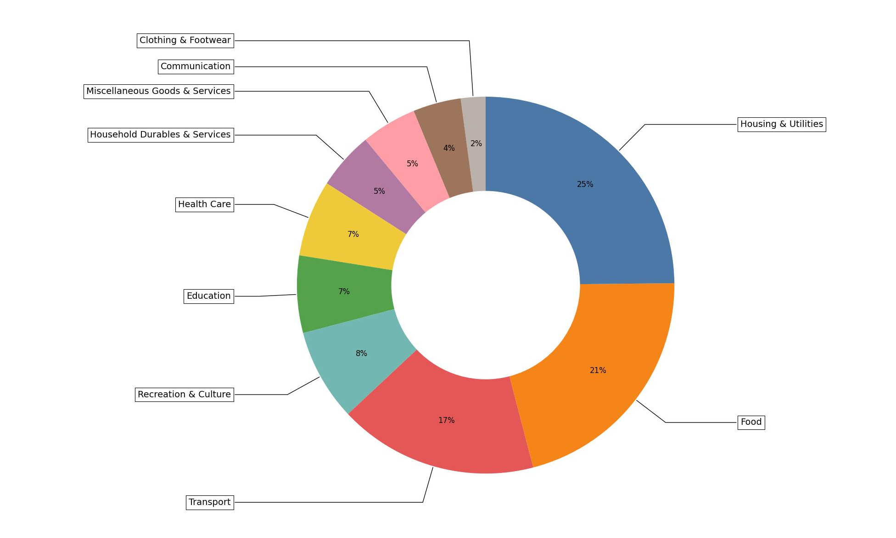













CPI Component WeightS
*Based on data from 2019 General household survey
Notes:
From the dataset with the CPI weightage
Pie chart with the % spendings for the general household population in Singapore
Top 3 spending categories are Housing, Food and Transport
The rest are like recreation, education, healthcare, household items, misc, communication and clothing
All these is based on the 2019 general household survey

Slide 12
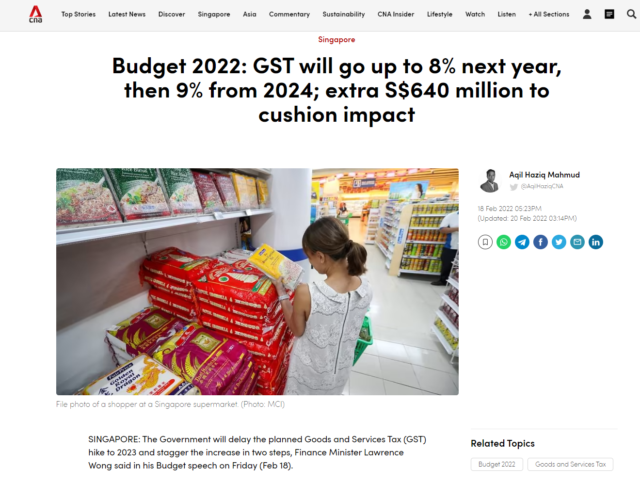
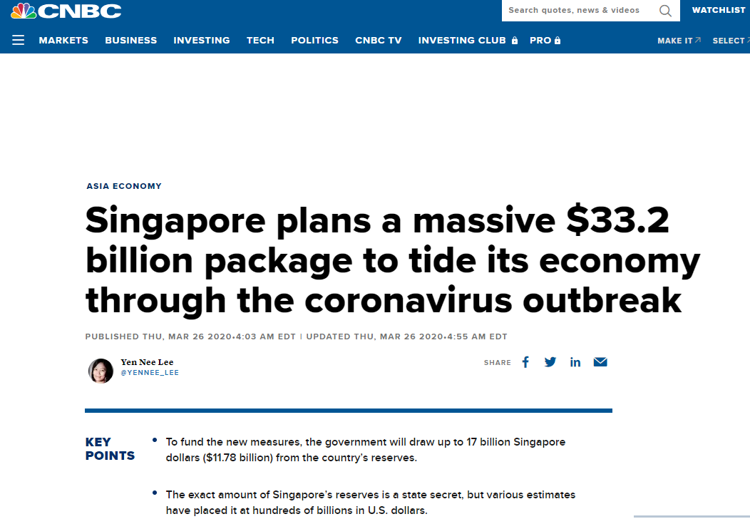
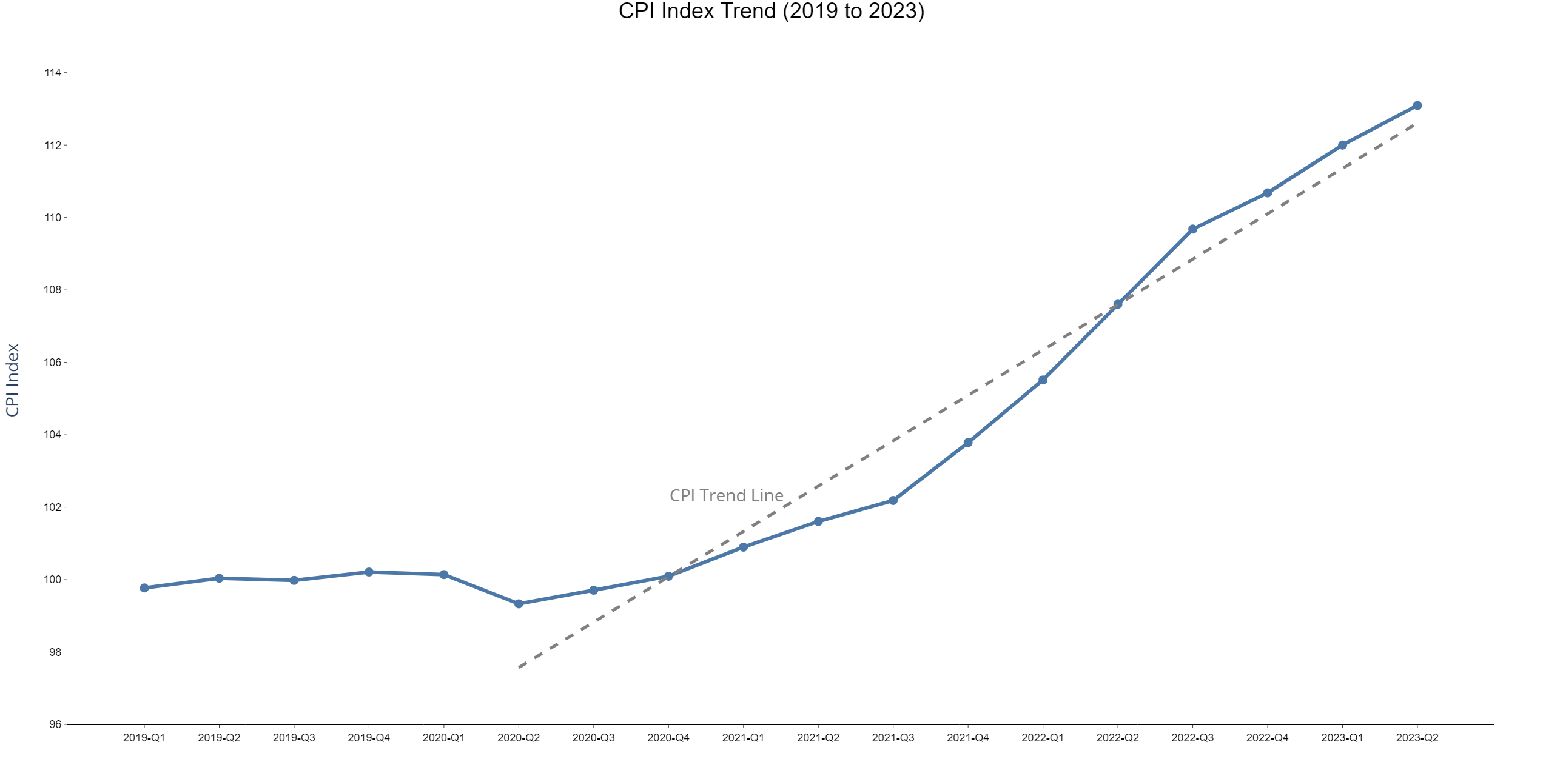

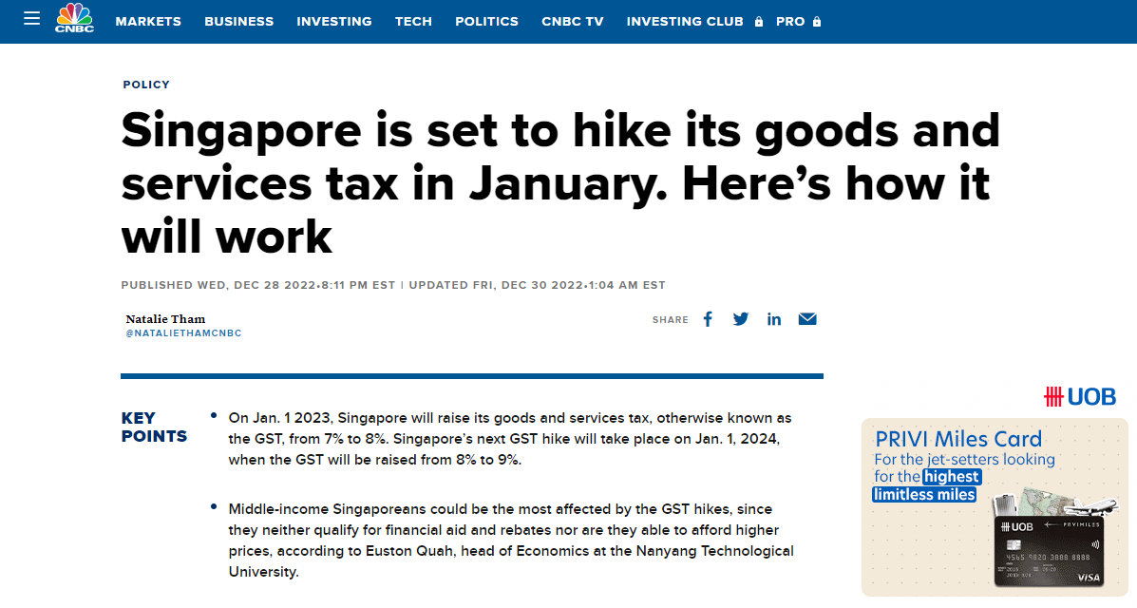
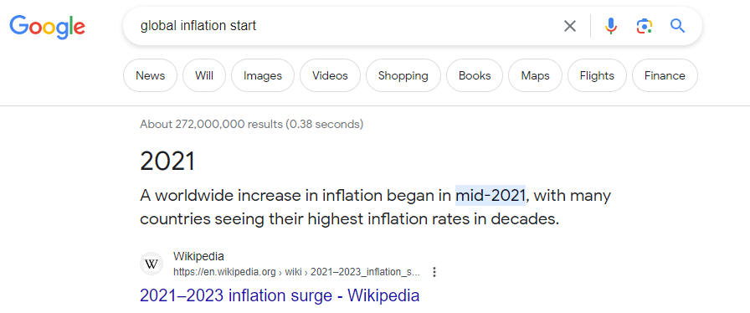
CPI Trend (2019 to 2023)
Insights:
Relatively flat from 2019 to 2020
Increased linearly from 2020-Q2 to 2023-Q2 from 99.3 to 113.1
CPI has increased by a total of 13% as compared to the beginning of 2019
GST increase to 8%
Announcement of GST increase
Government Stimulus Package
Worldwide increase in inflation
Start of Covid-19 Pandemic
Notes:
From the CPI index dataset, there the CPI trend line is plotted from 2019 to 2023
Flat till 2020, then linear increase from there till 2023 – as seen by the dotted trend line
Looking at affecting events
Start of the covid 19 pandemic
2020 Government stimulus package – free money, increase money supply leading to demand side inflation
2021 World wide increase in inflation – costlier when we buy goods from overseas leading to import driven inflation
2022 Announcement of GST hike followed by the actual gst hike – higher cost of goods and services leading to supply side inflation
All these drivers leads to a sustained increase in prices

Slide 13
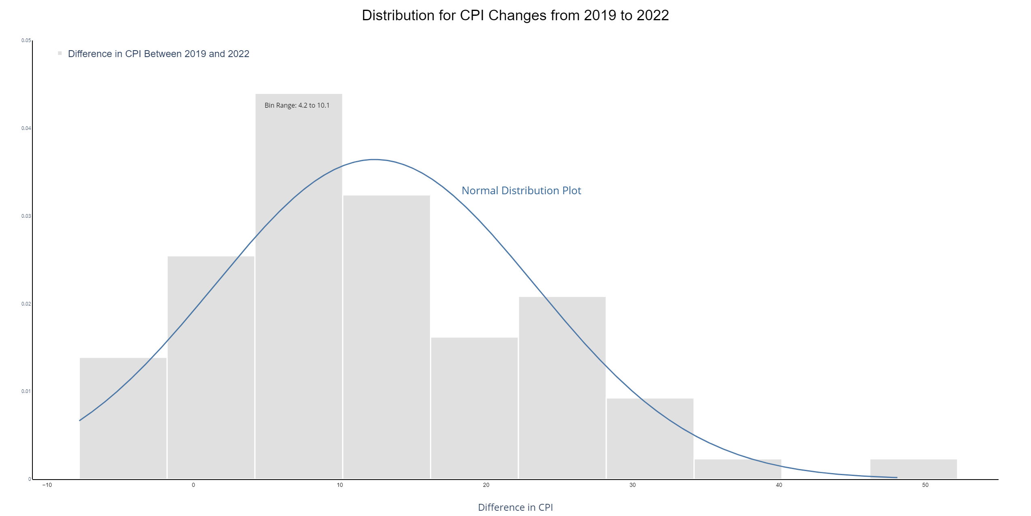
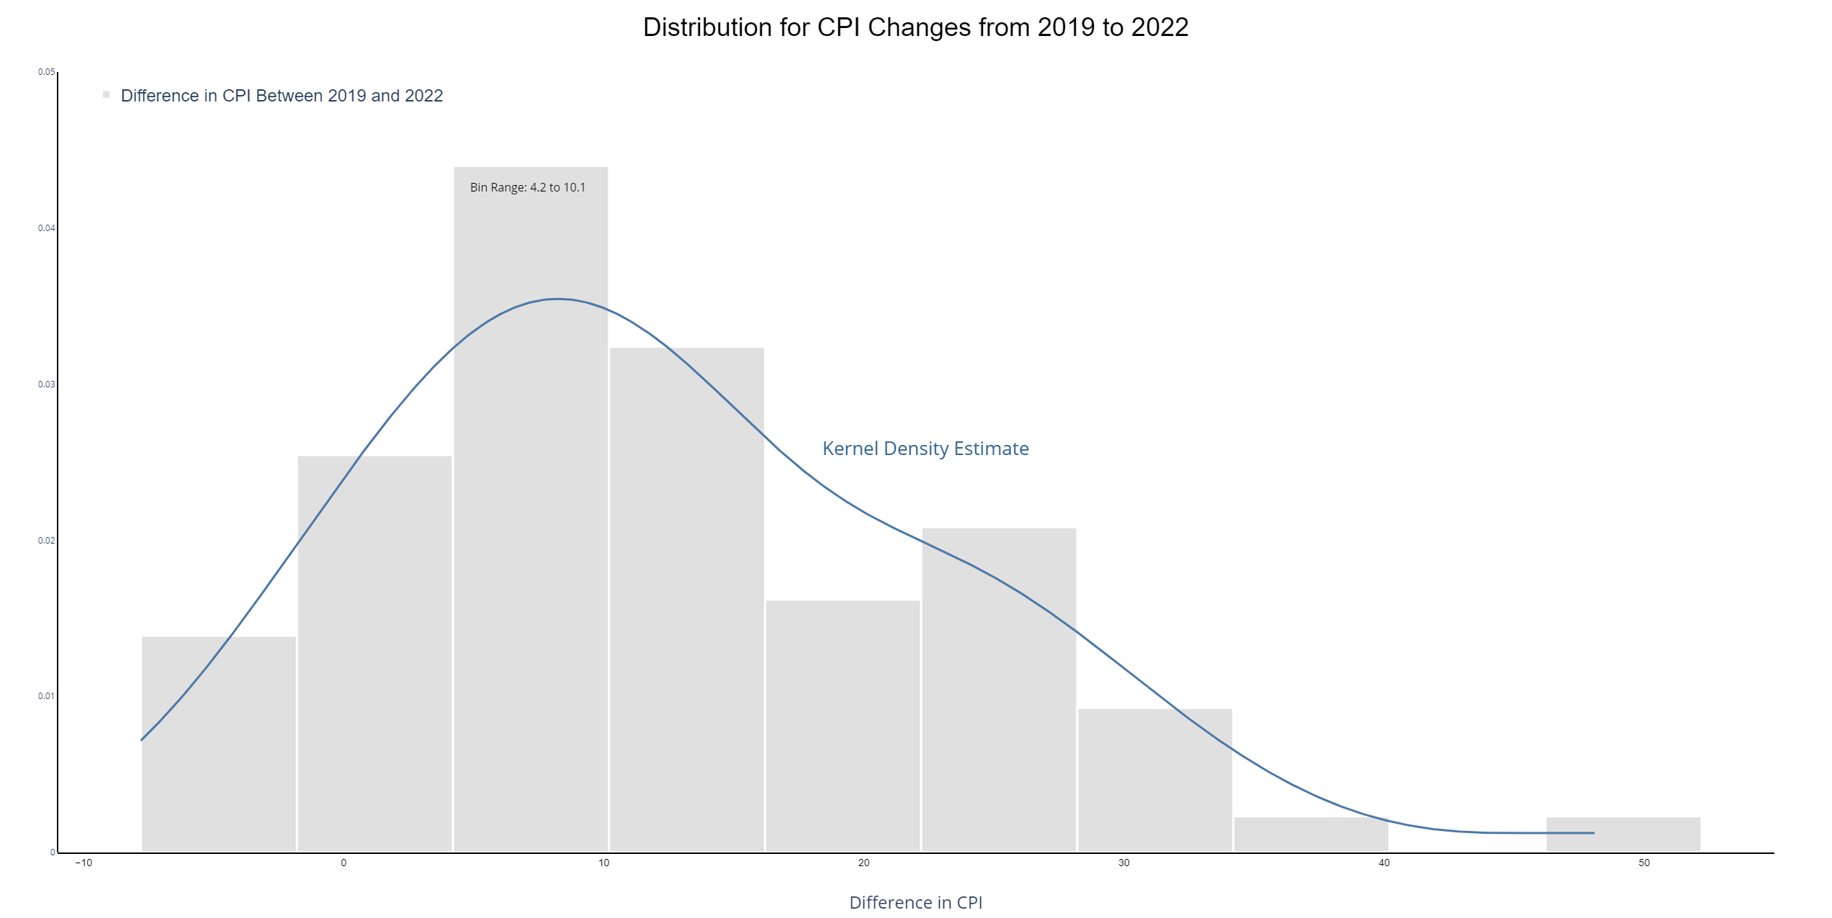
Distribution of CPI changes from 2019 to 2022
Insights:
The price increase approximates a normal distribution and is positively skewed
The largest number of components increased between 4.2 and 10.1 pts from 2019 to 2022
There is an outlier item with close to 50 pts increase over the 3 years
Modal Bin
Extreme Value
Notes:
We look at the distribution of the CPI component increases
Using the histogram I plotted the kernel density estimate as an overlay
.. using plotly, I then derive the fitted normal distribution plot
The distribution is positively skewed to the right
Most items have increased by between 4 to 10%
And there is an extreme outlier to the right of about 50pts or 50% increase
We will find out what it is next

Slide 14
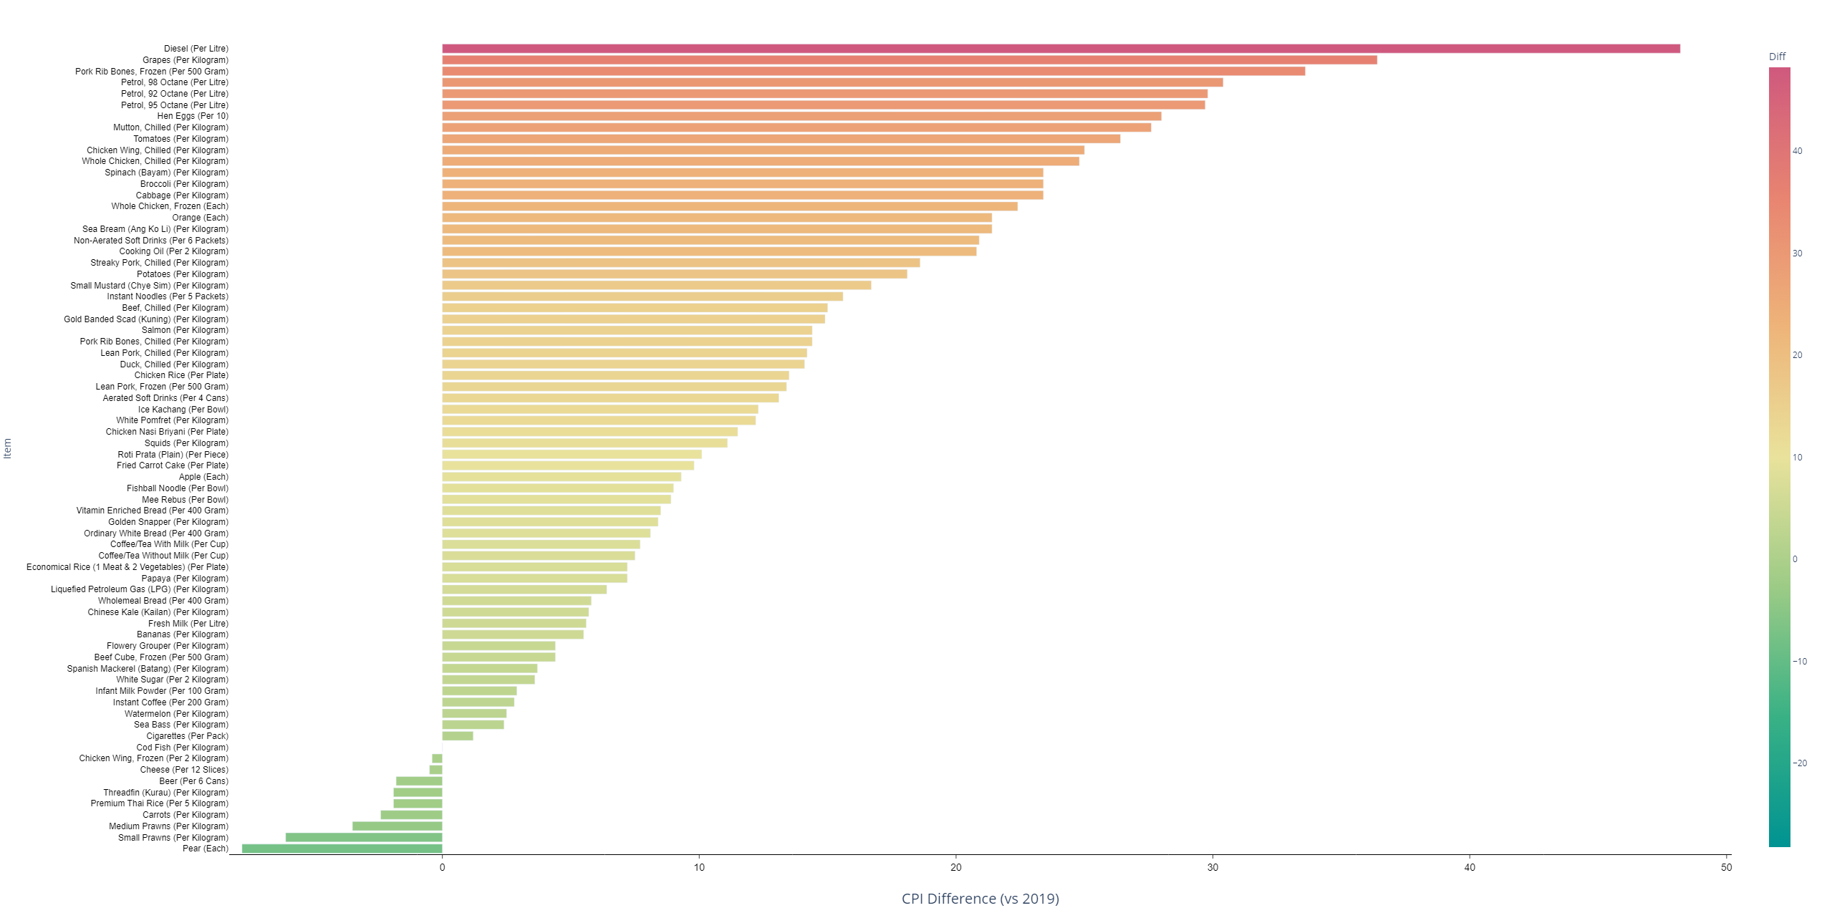
CPI ITEM PRICE CHANGES From 2019 to 2022
Insights:
Prices of 19 of the CPI component items increased by more than 20pts from 2019 to 2022
Prices of 9 items decreased from 2019 to 2022
The overall range is between -8 to +48pts
Notes:
Looking at the selected retail items
I plotted the difference in price between 2019 and 2022 and this is what we have
19 items increase by more than 20ots
9 items decreased in price
Range is between -8 to +48pts

Slide 15
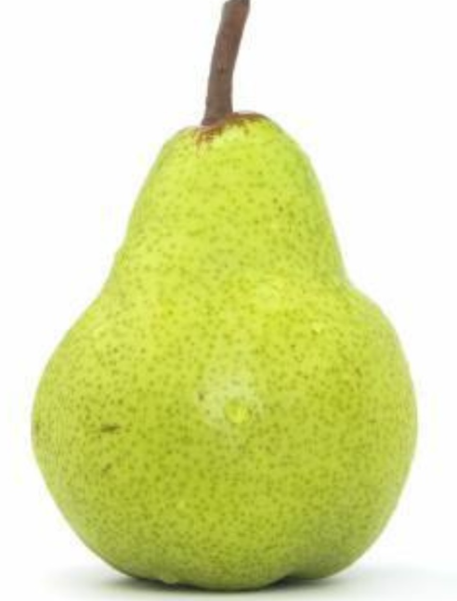

From 2019 to 2022
Top 5 Decreases :
Pear | -7.8
Small Prawns | -6.1
Medium Prawns | -3.5
Carrots | -2.4
Premium Thai Rice | -1.9
Top 5 Increases:
Petrol 92 Octane | +29.8
Petrol 98 Octane | +30.4
Pork Ribs | +33.6
Grapes | +36.4
Diesel | +48.2
Notes:
Good news
Pear, prawns, carrots, thai rice got cheaper
Bad news
Petrol, Diesel prices have increased substantially
Pork ribs just got quite a lot more expensive

Slide 16
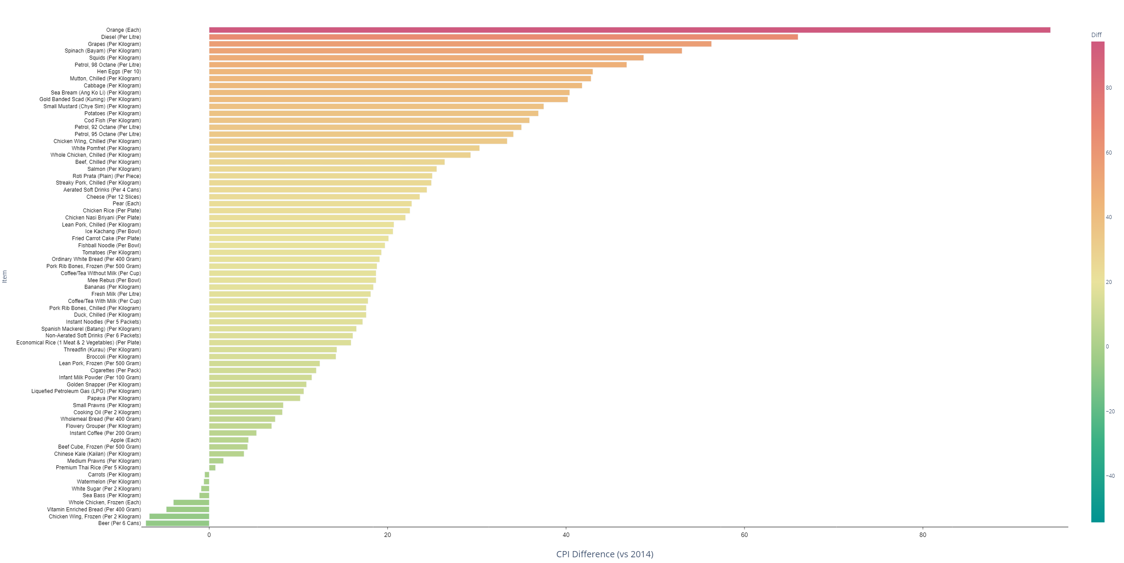
CPI ITEM PRICE CHANGES From 2014 to 2022
Insights:
Prices of 11 of the CPI component items increased by more than 40pts from 2014 to 2022
Prices of 8 items decreased from 2014 to 2022
The overall range is between -7 to +94pts
Notes:
Looking at the difference between 2014 to 2022
11 items increased by more than 40pts
8 items got cheaper
Overall range between -7 to +94pts

Slide 17


From 2014 to 2022
Top 5 Decreases :
Beer | -7.1
Frozen Chicken Wing | -6.7
Vitamin Enriched Bread | -4.8
Frozen Whole Chicken | -4
Sea Bass | -1.1
Top 5 Increases:
Squids | +48.7
Spinach | +53.0
Grapes | +56.3
Diesel | +66.0
Orange | +94.3
Notes:
Good news
Beer got cheaper
So did frozen chicken
Bad news
Squids, spinach got a lot more expensive
And oranges saw a 94pts increase – price is close to doubled

Slide 18
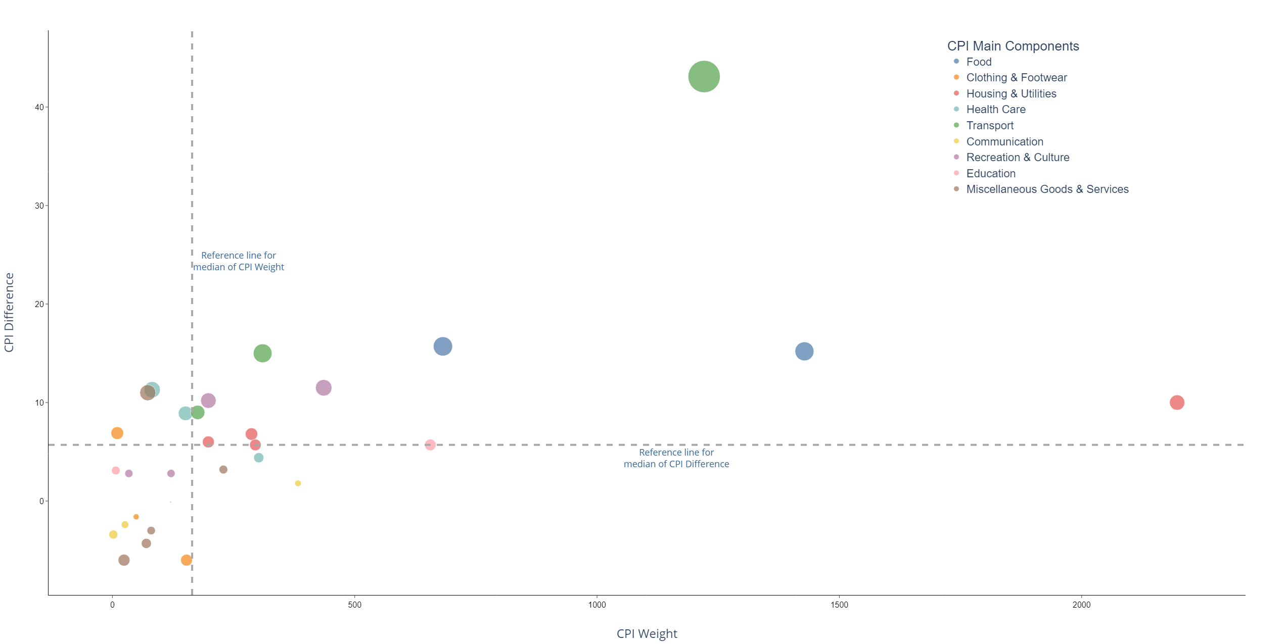
CPI Difference vs Weight (2022 data with 2019 as base)
Insights:
Components with negative or small price increase tends to be smaller in overall CPI weight
Components with larger price increase tends to be also contributing to a higher CPI weightage
Transport
Food
Housing & Utilities
Notes:
Earlier we saw the price movements. But that is only half of the story
We need to also factor in the weight.. How much we spend on those items
The 2 dataset is combined and we have the scatterplot of price vs weight
Insights.. Not very positive news for cost of living:
Extreme top right – We see transport food and housing as the groups that affect the cost of living most for the average household
However, the insights here is based on the average household, it may not be applicable to you due to different spending patterns

Slide 19

How does it matter to you?
Creating Actionable Insights Based on Custom Visualisations from User Input Data
Notes:
To make the data relevant to you I have created a python program to accept your user inputs for spending patterns which then generate personalised visuals based on the inputs

Slide 20
PYTHON CODE FOR CUSTOM USER INSIGHTS with SQL DATA EXTRACTION
Using Python libraries – Numpy, Pandas, Plotly and MySQL
Raw data is loaded into a pandas DataFrame via connection to MySQL database
Data is cleaned using Pandas
Custom new column for ‘Group’ is added using lambda function
Column sub-setting is done via Pandas splicing method
User inputs is done via the use of ‘for’ loop and list manipulation with exception handling
Calculation for user CPI is done using Numpy array vectorisation
Text generation and calculation for % difference is done via custom function definition
Final visuals are plotted using Matplotlib with 2 horizontal subplots

Slide 21
import pandas as pd import numpy as np import matplotlib.pyplot as plt import mysql.connector # The following code is used to connect to the database in a local SQL host # Connect to the mySQL database cnx = mysql.connector.connect(user = 'root', password = 'PassWord', host = '127.0.0.1', database = ‘cpiproject') sql_code = 'SELECT * FROM CPI_Quarterly' df = pd.read_sql(sql_code, con = cnx) # Rename the 'Data Series' to 'items' and remove empty spaces from the values in the column df = df.rename(columns={'Data Series' : 'items'}) df['items'] = df['items'].str.strip() # Trim the trailing spaces from the column headers df.columns = df.columns.str.strip() # Create a new column containing the difference in CPI value for '2023 2Q' and '2019 1Q' df['diff'] = df['2023 2Q'] - df['2019 1Q'] df['diff'] = df['diff'].round(1) # Extract the main categories for items and their corresponding rows main_category = ['Food', 'Clothing & Footwear', 'Housing & Utilities', 'Household Durables & Services', 'Health Care', 'Transport', 'Communication', 'Recreation & Culture', 'Education', 'Miscellaneous Goods & Services'] # Create a new column with values 'Main' or 'Sub' dependent on the values in the 'items' columns df['group'] = df['items'].apply(lambda x: 'Main' if x in main_category else 'Sub') # Extract the subset of the dataframe containing only the values for the main categories df_main = df[df['group'] == 'Main'] df_main_latest = df_main['2023 2Q'].reset_index() price = np.array(df_main_latest['2023 2Q']) items = np.array(df_main['items']) try: # Initialize an empty list to store user inputs user_inputs = [] print('\nEnter a numeric value between 0 to 100 for each of the CPI components ' 'based on the relative weight which you spend on the respective items\n') # Get 10 user inputs for i in range(len(items)): user_input = int(input(f'Value for {items[i]}: ')) if 0 <= user_input <= 100: user_inputs.append(user_input) else: print("Invalid input! Please enter a numeric value between 0 and 100.") exit() # Calculate the sum of user inputs total_sum = sum(user_inputs) # Refactor the values to ensure the total sum is 100 refactored_values = [(num / total_sum) * 100 for num in user_inputs] # Print the refactored values s='#' print(f'\n{s*40}\nYour CPI Weightage refactored to 100%:\n') for item, val in zip(items,refactored_values): print(f'{item}: {val:.1f}') print(f'\n{s*40}') except ValueError: print("Invalid input! Please enter an integer.") except Exception as e: print("An error occurred:", e) refactored_values = np.array(refactored_values) / 100 CPI_user = np.sum(price * refactored_values) CPI_2023 = 113.6 CPI_data = np.array([CPI_2023, CPI_user]) # Sorting the values in ascending order for better visualisation sorted_indices = np.argsort(user_inputs) sorted_user_inputs = np.array(user_inputs)[sorted_indices] sorted_items = np.array(items)[sorted_indices] # Define the figure and subplots fig, axs = plt.subplots(1, 2, width_ratios=[5,4]) # Define the color and plot the pie chart with custom layout, text attribute, percentage labels and positioning colors = ['#BAB0AC', '#9D755D', '#FF9DA6', '#B279A2', '#EECA3B', '#54A24B', '#72B7B2', '#E45756', '#F58518', '#4C78A8'] sector, _, __ = axs[0].pie(sorted_user_inputs, autopct="%1.1f%%", pctdistance=0.7, textprops={'size': 'large'}, startangle=90, colors = colors, wedgeprops=dict(width=0.7)) # Add the text labels with custom positioning, connecting lines and text borders bbox_props = dict(boxstyle='square,pad=0.3', fc='w', ec='k', lw=0.8) kw = dict(arrowprops=dict(arrowstyle='-'), bbox=bbox_props, zorder=0, va='center') # Use the for loop to define the positioning for each label for i, s in enumerate(sector): angle = (s.theta2 - s.theta1)/2. + s.theta1 y = np.sin(np.deg2rad(angle)) x = np.cos(np.deg2rad(angle)) horizontalalignment = {-1: 'right', 1: 'left'}[int(np.sign(x))] connectionstyle = f'angle,angleA=0,angleB={angle}' kw['arrowprops'].update({'connectionstyle': connectionstyle}) axs[0].annotate(sorted_items[i], xy=(x, y), fontsize=14, xytext=(1.2 * np.sign(x), 1.3 * y), ha=horizontalalignment, **kw) axs[0].set_title('Your CPI Component Weights', fontsize=28, fontweight='bold', pad=65) # Plot the bar chart in matplotlib with custom elements and add the chart title xlabels = ['General Household', 'You'] axs[1].bar(xlabels, CPI_data, label='Consumer Price Index', color = ['lightgray','tab:blue'], width=0.5) axs[1].tick_params(axis='x', which='both', pad =20, bottom=False, labelsize=20) axs[1].set_yticks([]) axs[1].spines['top'].set_visible(False) axs[1].spines['bottom'].set_visible(True) axs[1].spines['right'].set_visible(False) axs[1].spines['left'].set_visible(False) axs[1].set_ylim(60, 150) axs[1].set_title('CPI Benchmark Comparison', fontsize=28, fontweight='bold', pad=0) # Add the value labels for the bar chart for i in range(0, len(CPI_data)): label_text = f'{CPI_data[i]:.1f}' label_x = xlabels[i] label_y = CPI_data[i] - 2 text_obj = axs[1].text(label_x, label_y, label_text, ha='center', va='top', fontsize=14, color='black') text_obj.set_weight('bold') # Define a function to change the text description for the percentage difference of the CPI comparison based on the value of the computed user CPI def comparison(a,b): per_diff = abs((a - b) / b) * 100 if a > b: return f'Your computed CPI is greater than the general household benchmark by {per_diff:.1f}%' elif b > a: return f'Your computed CPI is less than the general household benchmark by {per_diff:.1f}%' else: return f'Your computed CPI is the same as the general household benchmark' result = comparison(CPI_user,CPI_2023) # Create the figure text box to include the text information into the chart label_text = result label_x = 0.6 label_y = 0.8 plt.figtext(label_x, label_y, label_text, ha='left', va='center', fontsize=16, fontfamily='Arial', fontweight='bold', color='black', in_layout=True, bbox=dict(facecolor='white', edgecolor='black', boxstyle='square')) # Adjust the horizontal space padding between the two charts plt.subplots_adjust(top=0.9) plt.subplots_adjust(wspace=0.6) # Plot the charts plt.show()

Slide 22
import pandas as pd import numpy as np import matplotlib.pyplot as plt import mysql.connector # The following code is used to connect to the database in a local SQL host # Connect to the mySQL database cnx = mysql.connector.connect(user = 'root', password = 'PassWord', host = '127.0.0.1', database = ‘cpiproject') sql_code = 'SELECT * FROM CPI_Quarterly' df = pd.read_sql(sql_code, con = cnx) # Rename the 'Data Series' to 'items' and remove empty spaces from the values in the column df = df.rename(columns={'Data Series' : 'items'}) df['items'] = df['items'].str.strip() # Trim the trailing spaces from the column headers df.columns = df.columns.str.strip() # Create a new column containing the difference in CPI value for '2023 2Q' and '2019 1Q' df['diff'] = df['2023 2Q'] - df['2019 1Q'] df['diff'] = df['diff'].round(1) # Extract the main categories for items and their corresponding rows main_category = ['Food', 'Clothing & Footwear', 'Housing & Utilities', 'Household Durables & Services', 'Health Care', 'Transport', 'Communication', 'Recreation & Culture', 'Education', 'Miscellaneous Goods & Services'] # Create a new column with values 'Main' or 'Sub' dependent on the values in the 'items' columns df['group'] = df['items'].apply(lambda x: 'Main' if x in main_category else 'Sub') # Extract the subset of the dataframe containing only the values for the main categories df_main = df[df['group'] == 'Main'] df_main_latest = df_main['2023 2Q'].reset_index() price = np.array(df_main_latest['2023 2Q']) items = np.array(df_main['items']) try: # Initialize an empty list to store user inputs user_inputs = [] print('\nEnter a numeric value between 0 to 100 for each of the CPI components ' 'based on the relative weight which you spend on the respective items\n') # Get 10 user inputs for i in range(len(items)): user_input = int(input(f'Value for {items[i]}: ')) if 0 <= user_input <= 100: user_inputs.append(user_input) else: print("Invalid input! Please enter a numeric value between 0 and 100.") exit() # Calculate the sum of user inputs total_sum = sum(user_inputs) # Refactor the values to ensure the total sum is 100 refactored_values = [(num / total_sum) * 100 for num in user_inputs] # Print the refactored values s='#' print(f'\n{s*40}\nYour CPI Weightage refactored to 100%:\n') for item, val in zip(items,refactored_values): print(f'{item}: {val:.1f}') print(f'\n{s*40}') except ValueError: print("Invalid input! Please enter an integer.") except Exception as e: print("An error occurred:", e) refactored_values = np.array(refactored_values) / 100 CPI_user = np.sum(price * refactored_values) CPI_2023 = 113.6 CPI_data = np.array([CPI_2023, CPI_user]) # Sorting the values in ascending order for better visualisation sorted_indices = np.argsort(user_inputs) sorted_user_inputs = np.array(user_inputs)[sorted_indices] sorted_items = np.array(items)[sorted_indices] # Define the figure and subplots fig, axs = plt.subplots(1, 2, width_ratios=[5,4]) # Define the color and plot the pie chart with custom layout, text attribute, percentage labels and positioning colors = ['#BAB0AC', '#9D755D', '#FF9DA6', '#B279A2', '#EECA3B', '#54A24B', '#72B7B2', '#E45756', '#F58518', '#4C78A8'] sector, _, __ = axs[0].pie(sorted_user_inputs, autopct="%1.1f%%", pctdistance=0.7, textprops={'size': 'large'}, startangle=90, colors = colors, wedgeprops=dict(width=0.7)) # Add the text labels with custom positioning, connecting lines and text borders bbox_props = dict(boxstyle='square,pad=0.3', fc='w', ec='k', lw=0.8) kw = dict(arrowprops=dict(arrowstyle='-'), bbox=bbox_props, zorder=0, va='center') # Use the for loop to define the positioning for each label for i, s in enumerate(sector): angle = (s.theta2 - s.theta1)/2. + s.theta1 y = np.sin(np.deg2rad(angle)) x = np.cos(np.deg2rad(angle)) horizontalalignment = {-1: 'right', 1: 'left'}[int(np.sign(x))] connectionstyle = f'angle,angleA=0,angleB={angle}' kw['arrowprops'].update({'connectionstyle': connectionstyle}) axs[0].annotate(sorted_items[i], xy=(x, y), fontsize=14, xytext=(1.2 * np.sign(x), 1.3 * y), ha=horizontalalignment, **kw) axs[0].set_title('Your CPI Component Weights', fontsize=28, fontweight='bold', pad=65) # Plot the bar chart in matplotlib with custom elements and add the chart title xlabels = ['General Household', 'You'] axs[1].bar(xlabels, CPI_data, label='Consumer Price Index', color = ['lightgray','tab:blue'], width=0.5) axs[1].tick_params(axis='x', which='both', pad =20, bottom=False, labelsize=20) axs[1].set_yticks([]) axs[1].spines['top'].set_visible(False) axs[1].spines['bottom'].set_visible(True) axs[1].spines['right'].set_visible(False) axs[1].spines['left'].set_visible(False) axs[1].set_ylim(60, 150) axs[1].set_title('CPI Benchmark Comparison', fontsize=28, fontweight='bold', pad=0) # Add the value labels for the bar chart for i in range(0, len(CPI_data)): label_text = f'{CPI_data[i]:.1f}' label_x = xlabels[i] label_y = CPI_data[i] - 2 text_obj = axs[1].text(label_x, label_y, label_text, ha='center', va='top', fontsize=14, color='black') text_obj.set_weight('bold') # Define a function to change the text description for the percentage difference of the CPI comparison based on the value of the computed user CPI def comparison(a,b): per_diff = abs((a - b) / b) * 100 if a > b: return f'Your computed CPI is greater than the general household benchmark by {per_diff:.1f}%' elif b > a: return f'Your computed CPI is less than the general household benchmark by {per_diff:.1f}%' else: return f'Your computed CPI is the same as the general household benchmark' result = comparison(CPI_user,CPI_2023) # Create the figure text box to include the text information into the chart label_text = result label_x = 0.6 label_y = 0.8 plt.figtext(label_x, label_y, label_text, ha='left', va='center', fontsize=16, fontfamily='Arial', fontweight='bold', color='black', in_layout=True, bbox=dict(facecolor='white', edgecolor='black', boxstyle='square')) # Adjust the horizontal space padding between the two charts plt.subplots_adjust(top=0.9) plt.subplots_adjust(wspace=0.6) # Plot the charts plt.show()

Slide 23
import pandas as pd import numpy as np import matplotlib.pyplot as plt import mysql.connector # The following code is used to connect to the database in a local SQL host # Connect to the mySQL database cnx = mysql.connector.connect(user = 'root', password = 'PassWord', host = '127.0.0.1', database = ‘cpiproject') sql_code = 'SELECT * FROM CPI_Quarterly' df = pd.read_sql(sql_code, con = cnx) # Rename the 'Data Series' to 'items' and remove empty spaces from the values in the column df = df.rename(columns={'Data Series' : 'items'}) df['items'] = df['items'].str.strip() # Trim the trailing spaces from the column headers df.columns = df.columns.str.strip() # Create a new column containing the difference in CPI value for '2023 2Q' and '2019 1Q' df['diff'] = df['2023 2Q'] - df['2019 1Q'] df['diff'] = df['diff'].round(1) # Extract the main categories for items and their corresponding rows main_category = ['Food', 'Clothing & Footwear', 'Housing & Utilities', 'Household Durables & Services', 'Health Care', 'Transport', 'Communication', 'Recreation & Culture', 'Education', 'Miscellaneous Goods & Services'] # Create a new column with values 'Main' or 'Sub' dependent on the values in the 'items' columns df['group'] = df['items'].apply(lambda x: 'Main' if x in main_category else 'Sub') # Extract the subset of the dataframe containing only the values for the main categories df_main = df[df['group'] == 'Main'] df_main_latest = df_main['2023 2Q'].reset_index() price = np.array(df_main_latest['2023 2Q']) items = np.array(df_main['items']) try: # Initialize an empty list to store user inputs user_inputs = [] print('\nEnter a numeric value between 0 to 100 for each of the CPI components ' 'based on the relative weight which you spend on the respective items\n') # Get 10 user inputs for i in range(len(items)): user_input = int(input(f'Value for {items[i]}: ')) if 0 <= user_input <= 100: user_inputs.append(user_input) else: print("Invalid input! Please enter a numeric value between 0 and 100.") exit() # Calculate the sum of user inputs total_sum = sum(user_inputs) # Refactor the values to ensure the total sum is 100 refactored_values = [(num / total_sum) * 100 for num in user_inputs] # Print the refactored values s='#' print(f'\n{s*40}\nYour CPI Weightage refactored to 100%:\n') for item, val in zip(items,refactored_values): print(f'{item}: {val:.1f}') print(f'\n{s*40}') except ValueError: print("Invalid input! Please enter an integer.") except Exception as e: print("An error occurred:", e) refactored_values = np.array(refactored_values) / 100 CPI_user = np.sum(price * refactored_values) CPI_2023 = 113.6 CPI_data = np.array([CPI_2023, CPI_user]) # Sorting the values in ascending order for better visualisation sorted_indices = np.argsort(user_inputs) sorted_user_inputs = np.array(user_inputs)[sorted_indices] sorted_items = np.array(items)[sorted_indices] # Define the figure and subplots fig, axs = plt.subplots(1, 2, width_ratios=[5,4]) # Define the color and plot the pie chart with custom layout, text attribute, percentage labels and positioning colors = ['#BAB0AC', '#9D755D', '#FF9DA6', '#B279A2', '#EECA3B', '#54A24B', '#72B7B2', '#E45756', '#F58518', '#4C78A8'] sector, _, __ = axs[0].pie(sorted_user_inputs, autopct="%1.1f%%", pctdistance=0.7, textprops={'size': 'large'}, startangle=90, colors = colors, wedgeprops=dict(width=0.7)) # Add the text labels with custom positioning, connecting lines and text borders bbox_props = dict(boxstyle='square,pad=0.3', fc='w', ec='k', lw=0.8) kw = dict(arrowprops=dict(arrowstyle='-'), bbox=bbox_props, zorder=0, va='center') # Use the for loop to define the positioning for each label for i, s in enumerate(sector): angle = (s.theta2 - s.theta1)/2. + s.theta1 y = np.sin(np.deg2rad(angle)) x = np.cos(np.deg2rad(angle)) horizontalalignment = {-1: 'right', 1: 'left'}[int(np.sign(x))] connectionstyle = f'angle,angleA=0,angleB={angle}' kw['arrowprops'].update({'connectionstyle': connectionstyle}) axs[0].annotate(sorted_items[i], xy=(x, y), fontsize=14, xytext=(1.2 * np.sign(x), 1.3 * y), ha=horizontalalignment, **kw) axs[0].set_title('Your CPI Component Weights', fontsize=28, fontweight='bold', pad=65) # Plot the bar chart in matplotlib with custom elements and add the chart title xlabels = ['General Household', 'You'] axs[1].bar(xlabels, CPI_data, label='Consumer Price Index', color = ['lightgray','tab:blue'], width=0.5) axs[1].tick_params(axis='x', which='both', pad =20, bottom=False, labelsize=20) axs[1].set_yticks([]) axs[1].spines['top'].set_visible(False) axs[1].spines['bottom'].set_visible(True) axs[1].spines['right'].set_visible(False) axs[1].spines['left'].set_visible(False) axs[1].set_ylim(60, 150) axs[1].set_title('CPI Benchmark Comparison', fontsize=28, fontweight='bold', pad=0) # Add the value labels for the bar chart for i in range(0, len(CPI_data)): label_text = f'{CPI_data[i]:.1f}' label_x = xlabels[i] label_y = CPI_data[i] - 2 text_obj = axs[1].text(label_x, label_y, label_text, ha='center', va='top', fontsize=14, color='black') text_obj.set_weight('bold') # Define a function to change the text description for the percentage difference of the CPI comparison based on the value of the computed user CPI def comparison(a,b): per_diff = abs((a - b) / b) * 100 if a > b: return f'Your computed CPI is greater than the general household benchmark by {per_diff:.1f}%' elif b > a: return f'Your computed CPI is less than the general household benchmark by {per_diff:.1f}%' else: return f'Your computed CPI is the same as the general household benchmark' result = comparison(CPI_user,CPI_2023) # Create the figure text box to include the text information into the chart label_text = result label_x = 0.6 label_y = 0.8 plt.figtext(label_x, label_y, label_text, ha='left', va='center', fontsize=16, fontfamily='Arial', fontweight='bold', color='black', in_layout=True, bbox=dict(facecolor='white', edgecolor='black', boxstyle='square')) # Adjust the horizontal space padding between the two charts plt.subplots_adjust(top=0.9) plt.subplots_adjust(wspace=0.6) # Plot the charts plt.show()

Slide 24
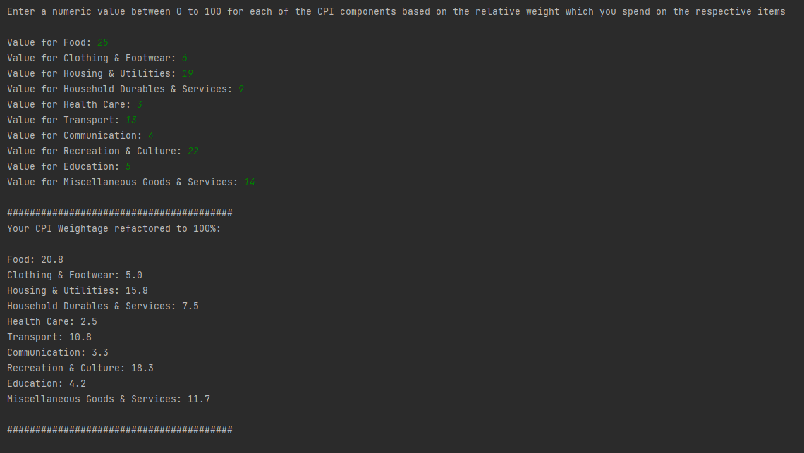
SAMPLE Python OUTPUT Based on USER inputs

Slide 25
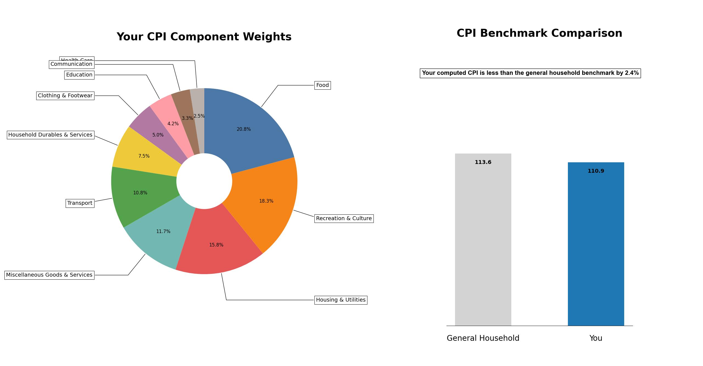
END user input for custom insights and analysis
Insights:
Python program to extract the data from SQL database and allow user custom input for spending pattern
Final spending weightage will be calculated and a comparison made to the benchmark CPI as at 2023-Q2
Notes:
Based on the personalised charts, the user will be able to understand his/her personal spending patterns and make comparison to the national benchmark to derive the relevant insights
With the custom insights, the individual will be able to see how inflation has affected them at an aggregated but yet personalised manner
This is a demonstration of how we talk data, use data, live with data and create actionable insights applicable to our daily lives and work

Slide 26

Thank you!!!

Slide 27
APPENDIX

Slide 28
SAMPLE PYTHON CODE FOR CPI weights
Using Python libraries – Numpy, Pandas & Matplotlib
Raw data is loaded into a pandas DataFrame
Custom new column for ‘Group’ is added using lambda function
Pie chart is plotted using Matplotlib
Custom labelling using circular sine and cosine positioning algorithm to define relative positionings

Slide 29
import pandas as pd import numpy as np import matplotlib.pyplot as plt # Read the excel file into the pandas dataframe path = 'assets/cpi-weights-2019-based.xlsx' df = pd.read_excel(path, skiprows=5, usecols=[0,1], names=['items', 'weights'], nrows=150) # Create a new column with values 'Main' or 'Sub' dependent on the values in the 'items' columns df['group'] = df['items'].apply(lambda x: 'Main' if x in ['Food', 'Clothing & Footwear', 'Housing & Utilities', 'Household Durables & Services', 'Health Care', 'Transport', 'Communication', 'Recreation & Culture', 'Education', 'Miscellaneous Goods & Services'] else 'Sub') # Reindex and sort by the 'weights' column in descending order df_main = df[df['group'] == 'Main'] df_main_sorted = df_main.sort_values('weights', ascending=True).reset_index() # Plotting the Pie Chart in matplotlib # Matplotlib is chosen over the other chart libraries because of its flexibility in using custom text labeling and annotations for the pie chart without the need for extremely complex coding # Define the figure and subplot fig, ax = plt.subplots() # Define the color and plot the pie chart with custom layout, text attribute, percentage labels and positioning colors = ['#BAB0AC', '#9D755D', '#FF9DA6', '#B279A2', '#EECA3B', '#54A24B', '#72B7B2', '#E45756', '#F58518', '#4C78A8'] sector, _, __ = ax.pie(df_main_sorted['weights'], autopct="%1.0f%%", pctdistance=0.75, textprops={'size': 'large'}, startangle=90, colors = colors, wedgeprops=dict(width=0.5)) # Add the text labels with custom positioning, connecting lines and text borders bbox_props = dict(boxstyle='square,pad=0.3', fc='w', ec='k', lw=0.8) kw = dict(arrowprops=dict(arrowstyle='-'), bbox=bbox_props, zorder=0, va='center') # Use the for loop to define the positioning for each element with slight adjustment for the vertical value of the first item for i, s in enumerate(sector): angle = (s.theta2 - s.theta1)/2. + s.theta1 y = np.sin(np.deg2rad(angle)) x = np.cos(np.deg2rad(angle)) horizontalalignment = {-1: 'right', 1: 'left'}[int(np.sign(x))] connectionstyle = f'angle,angleA=0,angleB={angle}' kw['arrowprops'].update({'connectionstyle': connectionstyle}) if i > 0: ax.annotate(df_main_sorted['items'][i], xy=(x, y), fontsize=14, xytext=(1.35 * np.sign(x), 1.2 * y), ha=horizontalalignment, **kw) else: ax.annotate(df_main_sorted['items'][i], xy=(x, y), fontsize=14, xytext=(1.35 * np.sign(x), 1.3 * y), ha=horizontalalignment, **kw) # Add the chart title plt.title('CPI Component Weights', fontsize=28, fontweight='bold', pad=90) plt.show()

Slide 30
SAMPLE PYTHON CODE FOR QUARTERLY CPI AND TREND LINE
Using Python libraries – Numpy, Pandas & Plotly
Raw data is loaded into a pandas DataFrame
The wide data table is converted to a tall format using Pandas with custom new column added using lambda function
Regression line for CPI trend is computed using Numpy
Line chart and calculated trend line is plotted with Plotly Express
Custom elements and interactivity of the chart is enhanced using both layout and traces layer updates

Slide 31
import pandas as pd import numpy as np import plotly.express as px # Read the csv file into the pandas dataframe path = 'assets/CPI_Quarterly.csv' df = pd.read_csv(path, sep=',', skiprows=10, nrows=1) # Take the data range from 2019 1Q to 2023 2Q df_filtered = df.loc[:,'2023 2Q ':'2019 1Q'] # Use the melt() function to convert the filtered DataFrame df_melted = df_filtered.melt(var_name='Quarter', value_name='CPI Index') # Modify the 'Quarter' column to the format YYYY-QQ df_melted['Quarter'] = df_melted['Quarter'].apply(lambda x: x[:4] + '-Q' + x[5]) # Sort the 'Quarter' column in ascending order df_sorted = df_melted.sort_index(ascending=False) df_trend = df_sorted[(df_sorted['Quarter'] >= '2020-Q2')] CPI = df_sorted['CPI Index'] # Calculate the equation for the trend line coefficients = np.polyfit(np.arange(0,len(df_trend)), df_trend['CPI Index'], 1) slope = coefficients[0] intercept = coefficients[1] def linear_equation(x): return slope * x + intercept # Define the values for the Trend Line for use with Plotly x = np.arange(0,len(df_trend)) y = linear_equation(x) # Create the line chart using Plotly Express fig = px.line(df_sorted, x='Quarter', y='CPI Index', markers=True) # Customise the color and size of the line and markers fig.update_traces( marker=dict(size=15), line=dict(width=6, color='#4C78A8') ) # Update plotly layout layer with the custom settings for chart title, xaxis, yaxis, plot background and legend fig.update_layout( title={ 'text': 'CPI Index Trend (2019 to 2023)', 'x': 0.5, # Set the title's x-position to the center 'font': {'family': 'Arial', 'size': 36, 'color': 'black'}, }, xaxis=dict( title='', showgrid=False, showline=True, linewidth=1, linecolor='black', showticklabels=True, ticks='outside', tickfont=dict( family='Arial', size=18, color='rgb(0, 0, 0)', ) ), yaxis=dict( title='CPI Index', title_standoff=40, # Add space padding for the x-axis title title_font={'size': 28}, showgrid=False, showline=True, linewidth=1, linecolor='black', range=[96, 115], zeroline=False, showticklabels=True, ticks='outside', tickfont=dict( family='Arial', size=18, color='rgb(0, 0, 0)', ) ), plot_bgcolor='rgba(0, 0, 0, 0)', showlegend=False ) # Add the CPI Trend Line plotted on the same primary axis fig.add_scatter( x=df_trend['Quarter'], y=y, mode = 'lines', line = dict(color='gray', width=5, dash='dash'), name = '', hovertemplate='<b>CPI Trend Line</b>' ) # Add the text label for the trend line label_annotation_line = dict( x=df_sorted['Quarter'][10], y=102, # Adjust the y-coordinate of the label text='CPI Trend Line', # Label text showarrow=False, xanchor='left', yanchor='bottom', font=dict(color='gray', size=28) # Label text color ) fig.add_annotation(label_annotation_line) # Update hover tooltip display using update_traces fig.update_traces( hovertemplate='<b>Period:</b> %{x}<br>' '<b>CPI Index:</b> %{y}<br>', hoverlabel = dict(font_size = 16, font_family = 'Arial') ) # Show the charts fig.show()

Slide 32
import pandas as pd import numpy as np import plotly.express as px # Read the csv file into the pandas dataframe path = 'assets/CPI_Quarterly.csv' df = pd.read_csv(path, sep=',', skiprows=10, nrows=1) # Take the data range from 2019 1Q to 2023 2Q df_filtered = df.loc[:,'2023 2Q ':'2019 1Q'] # Use the melt() function to convert the filtered DataFrame df_melted = df_filtered.melt(var_name='Quarter', value_name='CPI Index') # Modify the 'Quarter' column to the format YYYY-QQ df_melted['Quarter'] = df_melted['Quarter'].apply(lambda x: x[:4] + '-Q' + x[5]) # Sort the 'Quarter' column in ascending order df_sorted = df_melted.sort_index(ascending=False) df_trend = df_sorted[(df_sorted['Quarter'] >= '2020-Q2')] CPI = df_sorted['CPI Index'] # Calculate the equation for the trend line coefficients = np.polyfit(np.arange(0,len(df_trend)), df_trend['CPI Index'], 1) slope = coefficients[0] intercept = coefficients[1] def linear_equation(x): return slope * x + intercept # Define the values for the Trend Line for use with Plotly x = np.arange(0,len(df_trend)) y = linear_equation(x) # Create the line chart using Plotly Express fig = px.line(df_sorted, x='Quarter', y='CPI Index', markers=True) # Customise the color and size of the line and markers fig.update_traces( marker=dict(size=15), line=dict(width=6, color='#4C78A8') ) # Update plotly layout layer with the custom settings for chart title, xaxis, yaxis, plot background and legend fig.update_layout( title={ 'text': 'CPI Index Trend (2019 to 2023)', 'x': 0.5, # Set the title's x-position to the center 'font': {'family': 'Arial', 'size': 36, 'color': 'black'}, }, xaxis=dict( title='', showgrid=False, showline=True, linewidth=1, linecolor='black', showticklabels=True, ticks='outside', tickfont=dict( family='Arial', size=18, color='rgb(0, 0, 0)', ) ), yaxis=dict( title='CPI Index', title_standoff=40, # Add space padding for the x-axis title title_font={'size': 28}, showgrid=False, showline=True, linewidth=1, linecolor='black', range=[96, 115], zeroline=False, showticklabels=True, ticks='outside', tickfont=dict( family='Arial', size=18, color='rgb(0, 0, 0)', ) ), plot_bgcolor='rgba(0, 0, 0, 0)', showlegend=False ) # Add the CPI Trend Line plotted on the same primary axis fig.add_scatter( x=df_trend['Quarter'], y=y, mode = 'lines', line = dict(color='gray', width=5, dash='dash'), name = '', hovertemplate='<b>CPI Trend Line</b>' ) # Add the text label for the trend line label_annotation_line = dict( x=df_sorted['Quarter'][10], y=102, # Adjust the y-coordinate of the label text='CPI Trend Line', # Label text showarrow=False, xanchor='left', yanchor='bottom', font=dict(color='gray', size=28) # Label text color ) fig.add_annotation(label_annotation_line) # Update hover tooltip display using update_traces fig.update_traces( hovertemplate='<b>Period:</b> %{x}<br>' '<b>CPI Index:</b> %{y}<br>', hoverlabel = dict(font_size = 16, font_family = 'Arial') ) # Show the charts fig.show()

Slide 33
import pandas as pd import numpy as np import plotly.express as px # Read the csv file into the pandas dataframe path = 'assets/CPI_Quarterly.csv' df = pd.read_csv(path, sep=',', skiprows=10, nrows=1) # Take the data range from 2019 1Q to 2023 2Q df_filtered = df.loc[:,'2023 2Q ':'2019 1Q'] # Use the melt() function to convert the filtered DataFrame df_melted = df_filtered.melt(var_name='Quarter', value_name='CPI Index') # Modify the 'Quarter' column to the format YYYY-QQ df_melted['Quarter'] = df_melted['Quarter'].apply(lambda x: x[:4] + '-Q' + x[5]) # Sort the 'Quarter' column in ascending order df_sorted = df_melted.sort_index(ascending=False) df_trend = df_sorted[(df_sorted['Quarter'] >= '2020-Q2')] CPI = df_sorted['CPI Index'] # Calculate the equation for the trend line coefficients = np.polyfit(np.arange(0,len(df_trend)), df_trend['CPI Index'], 1) slope = coefficients[0] intercept = coefficients[1] def linear_equation(x): return slope * x + intercept # Define the values for the Trend Line for use with Plotly x = np.arange(0,len(df_trend)) y = linear_equation(x) # Create the line chart using Plotly Express fig = px.line(df_sorted, x='Quarter', y='CPI Index', markers=True) # Customise the color and size of the line and markers fig.update_traces( marker=dict(size=15), line=dict(width=6, color='#4C78A8') ) # Update plotly layout layer with the custom settings for chart title, xaxis, yaxis, plot background and legend fig.update_layout( title={ 'text': 'CPI Index Trend (2019 to 2023)', 'x': 0.5, # Set the title's x-position to the center 'font': {'family': 'Arial', 'size': 36, 'color': 'black'}, }, xaxis=dict( title='', showgrid=False, showline=True, linewidth=1, linecolor='black', showticklabels=True, ticks='outside', tickfont=dict( family='Arial', size=18, color='rgb(0, 0, 0)', ) ), yaxis=dict( title='CPI Index', title_standoff=40, # Add space padding for the x-axis title title_font={'size': 28}, showgrid=False, showline=True, linewidth=1, linecolor='black', range=[96, 115], zeroline=False, showticklabels=True, ticks='outside', tickfont=dict( family='Arial', size=18, color='rgb(0, 0, 0)', ) ), plot_bgcolor='rgba(0, 0, 0, 0)', showlegend=False ) # Add the CPI Trend Line plotted on the same primary axis fig.add_scatter( x=df_trend['Quarter'], y=y, mode = 'lines', line = dict(color='gray', width=5, dash='dash'), name = '', hovertemplate='<b>CPI Trend Line</b>' ) # Add the text label for the trend line label_annotation_line = dict( x=df_sorted['Quarter'][10], y=102, # Adjust the y-coordinate of the label text='CPI Trend Line', # Label text showarrow=False, xanchor='left', yanchor='bottom', font=dict(color='gray', size=28) # Label text color ) fig.add_annotation(label_annotation_line) # Update hover tooltip display using update_traces fig.update_traces( hovertemplate='<b>Period:</b> %{x}<br>' '<b>CPI Index:</b> %{y}<br>', hoverlabel = dict(font_size = 16, font_family = 'Arial') ) # Show the charts fig.show()

Slide 34
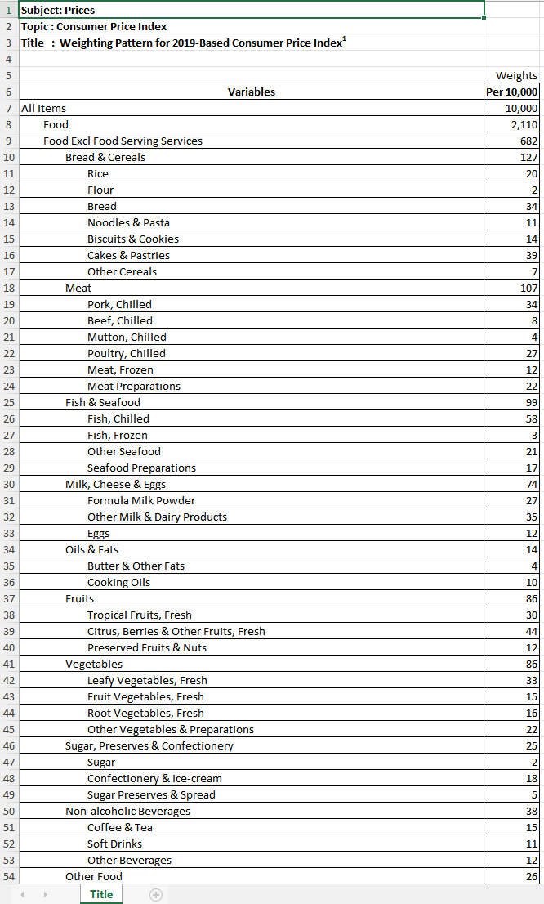
Dataset 1 – CPI Weightage

Slide 35
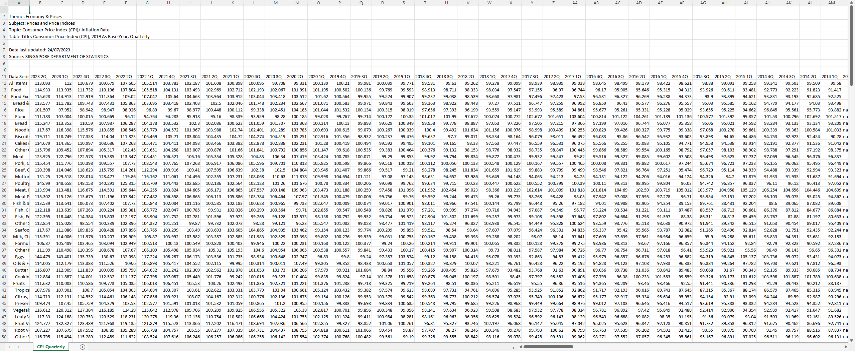
Dataset 2 – CPI Index by Quarter

Slide 36
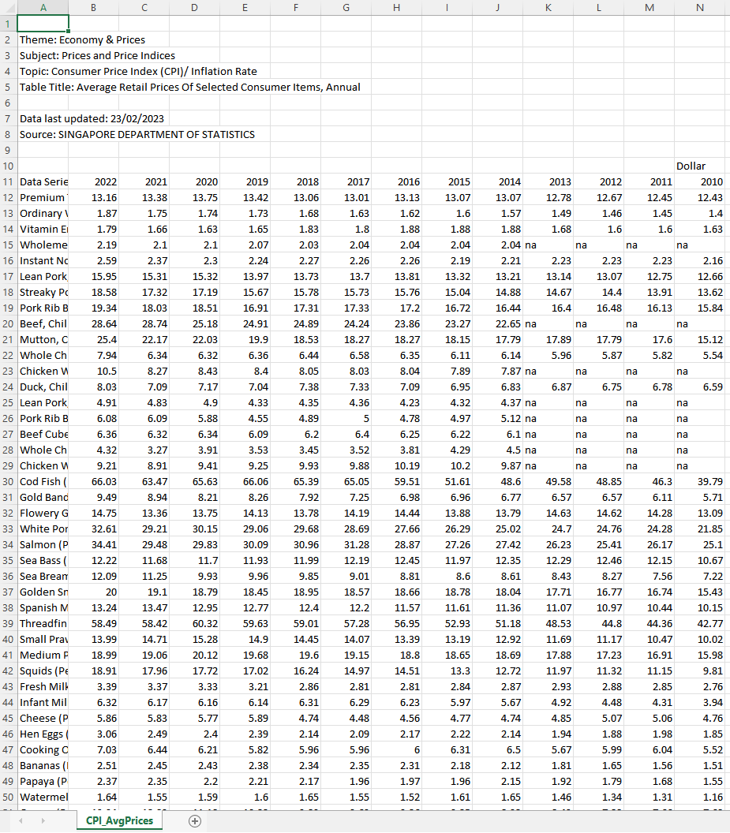
Dataset 3 – Average Retail prices, annual

